Slide 1

Space Syntax Toolkit for QGIS Introduction and recent developments
Jorge Gil
Stephen Law
Ioanna Kolovou
Abhimanyu Acharya
Space Syntax Laboratory - UCL
Space Syntax Limited
11th International Space Syntax Symposium
Fundação Calouste Gulbenkian, Lisbon
3rd July 2017

Slide 2
Introduction
Who we are
Jorge Gil MSc, PhD
Researcher UCL, Chalmers, TU Delft
Open Source GIS consultant and developer
Author ‘Space Syntax Toolkit’ for QGIS (2013 - )
Author ‘Confeego’ for MapInfo (2004 - 09)
Stephen Law MSc
Researcher, Turing Institute, UCL
Associate, Space Syntax Limited
Ioanna Kolovou MRes
Senior Consultant, Space Syntax Limited
Abhimanyu Acharya MSc
Senior Consultant, Space Syntax Limited

Slide 3
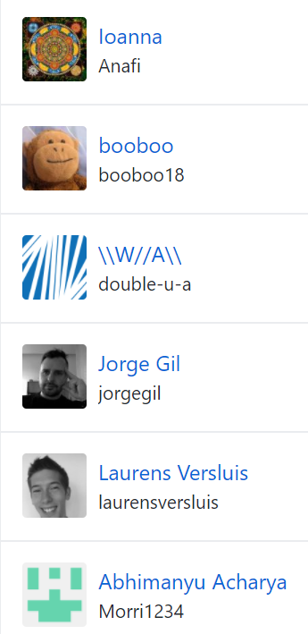
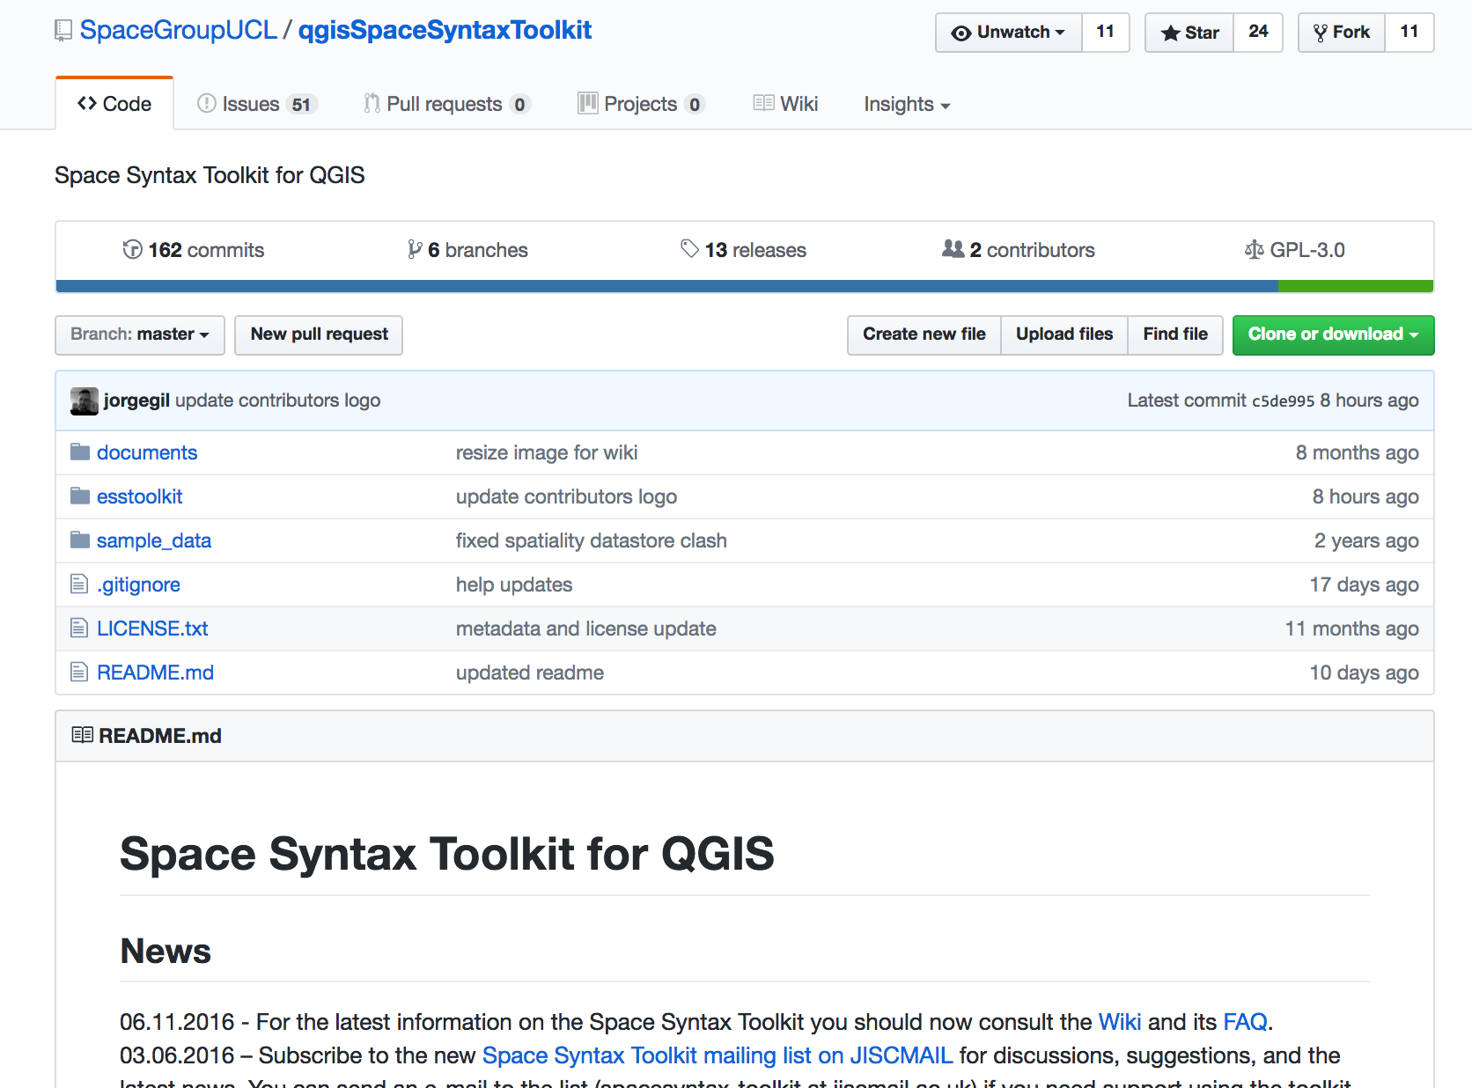
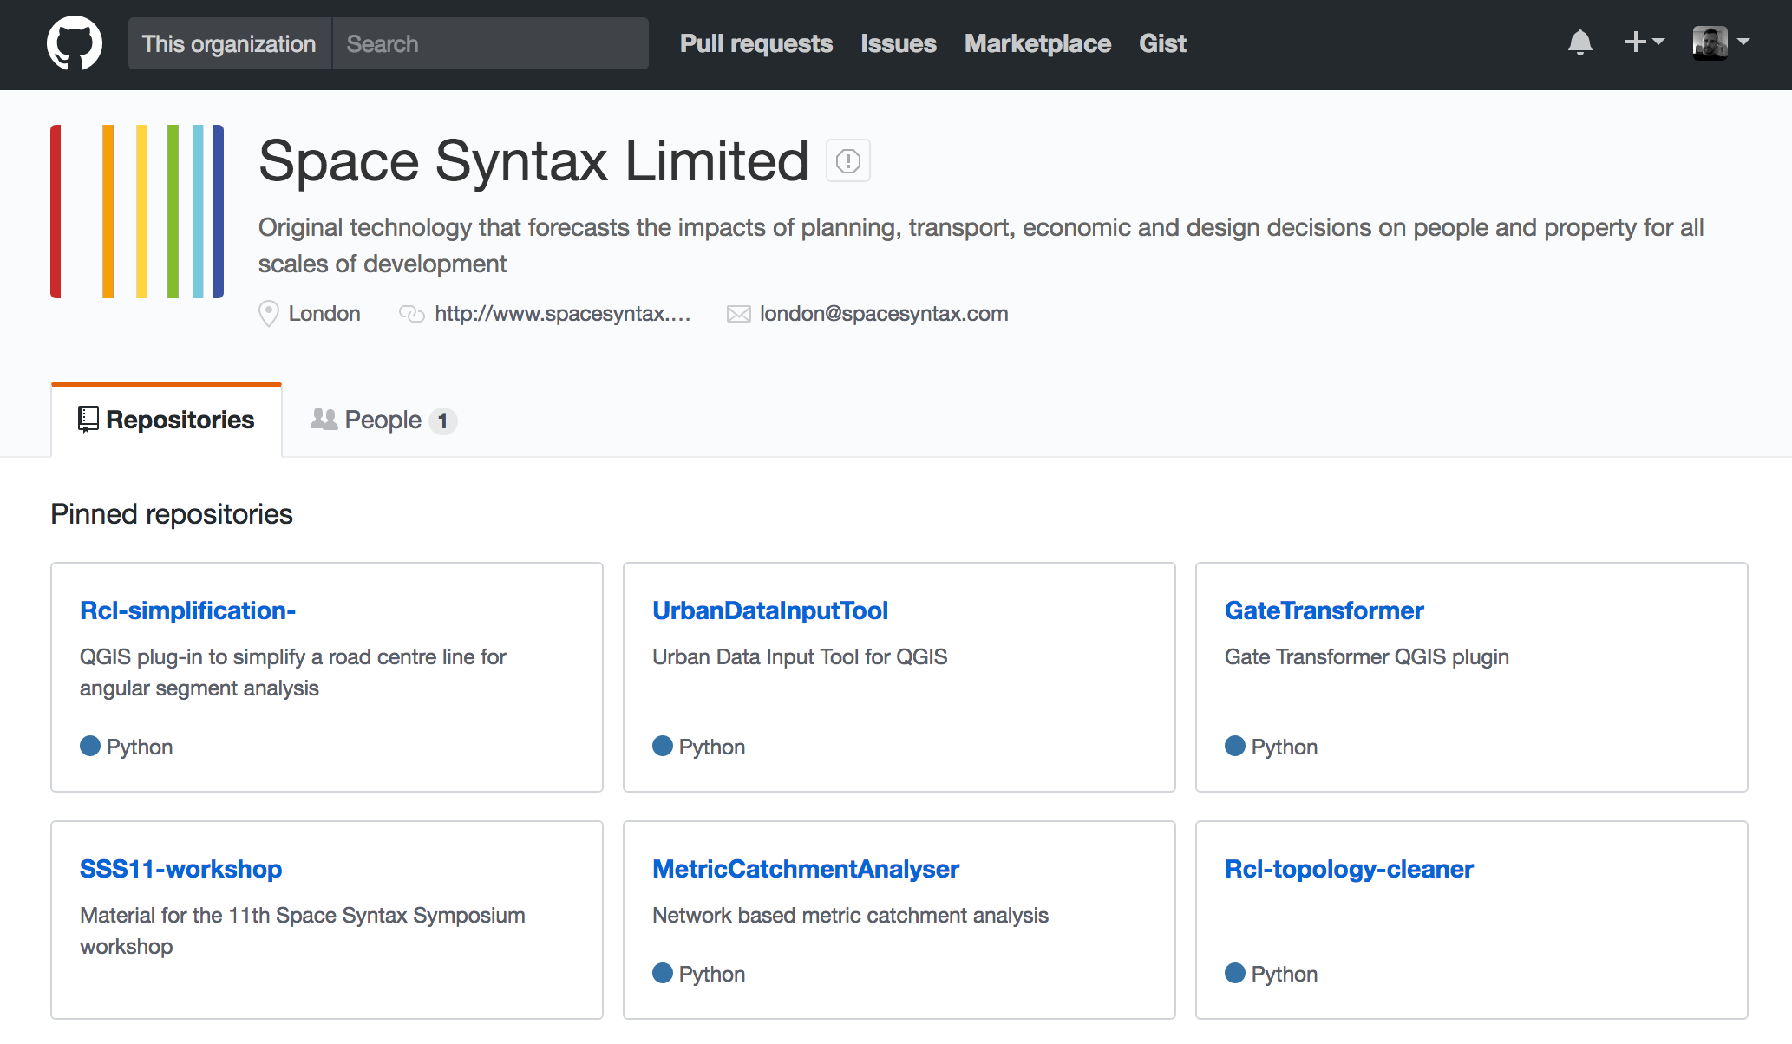
Introduction

Slide 4
Introduction
Who are you?
Name and affiliation

Slide 5
Introduction
Who are you?
 | Yes / Some | No
space syntax | 6 | 1
depthmapX | 5 | 2
QGIS | 2 | 5
GIS | 3 | 3
Note: based on 7 participant’s responses.

Slide 6
Introduction
Objectives
Learn how to use the 'Space Syntax Toolkit' (SST) for QGIS
Learn about its latest features and tools
Explore various space syntax analysis workflows in QGIS
Main objective is not to…
Learn about space syntax theory and methods
Learn about the depthmapX software
Learn about specific space syntax applications in research

Slide 7
Introduction
Requirements
Participants must bring their own laptops in order to carry out the exercises, with the necessary software pre-installed:
QGIS 2.14 LTR (or higher):
http://qgis.org/en/site/forusers/download.html
depthmapXnet 0.35:
http://archtech.gr/varoudis/depthmapX/?dir=depthmapXnet
Space Syntax Toolkit:
https://github.com/SpaceGroupUCL/qgisSpaceSyntaxToolkit/wiki/Installation

Slide 8
Introduction
Programme
09:30 Introduction to the workshop
09:45 Overview of space syntax and the SST project
10:00 Task 1: Preparing and analysing axial models
11:00 Break
11:45 Task 2: Preparing and analysing road centre line models
12:30 Visualisation and discussion of the results
13:00 Lunch Break
14:00 Task 3: Preparing other urban data layers
15:00 Task 4: Connecting and analysing the various results
16:00 Discussion on QGIS methods for space syntax research
16:30 Close

Slide 9
Overview
Space syntax theory and the SST project
Overview of relevant space syntax concepts
Overview of the SST project
SST installation in QGIS and downloading the sample data set

Slide 10
Space syntax theory
Relevant space syntax concepts
Representing space: axial maps and unlinks
Topology of space: graphs and centrality analysis
Segment maps and angular centrality analysis
Radius and distances

Slide 11
Space syntax theory
Representing space: axial maps and unlinks
The axial map is a linear representation of space, with the fewest longest set of straight lines that covers all spaces.
Source: Hillier, B., Hanson, J., 1984. The Social Logic of Space. Cambridge University Press, Cambridge, UK

Slide 12
Space syntax theory
Representing space: axial maps and unlinks
The axial map is a linear representation of space, with the fewest longest set of straight lines that covers all spaces.
Unlinks are features that mark a location where the intersection between two axial lines does not allow a change of direction.
Source: Hillier, B., Hanson, J., 1984. The Social Logic of Space. Cambridge University Press, Cambridge, UK

Slide 13
Space syntax theory
Topology of space: graphs and centrality analysis
Axial maps are translated into mathematical graphs where every line represents a node, and every intersection between lines represents an edge, or link.
Where there is an unlink, no edge is created, because there is no intersection.

Slide 14
Space syntax theory
Topology of space: graphs and centrality analysis
Connectivity
(Degree centrality)
Number of connected nodes
Mean Depth → Integration
(Closeness centrality)
Average distance to all other nodes
Choice
(Betweenness centrality)
Number of times on the shortest path
Between pairs of nodes

Slide 15
Space syntax theory
Topology of space: graphs and centrality analysis
Source: Al-Sayed, K., Turner, A., Hillier, B., Iida, S., Penn, A., 2015. Space Syntax methodology. Bartlett School of Architecture, UCL, London.

Slide 16
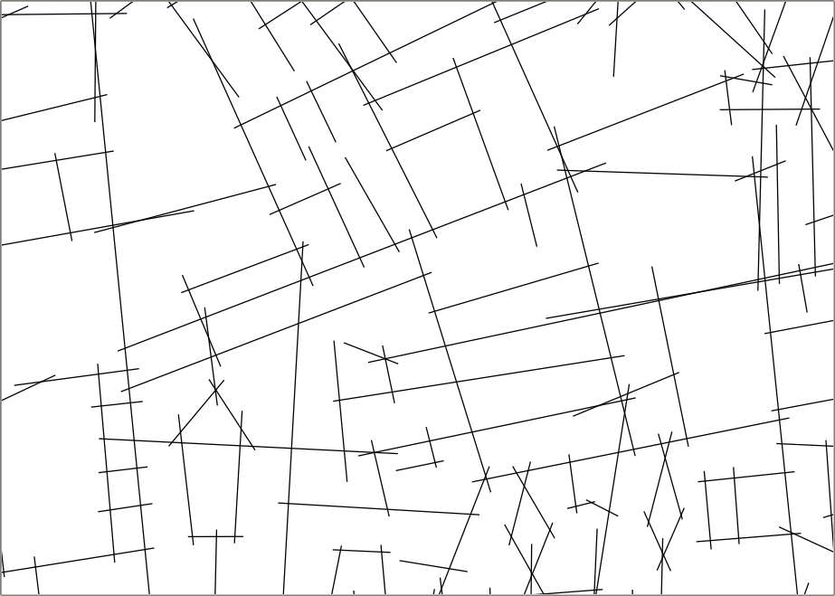
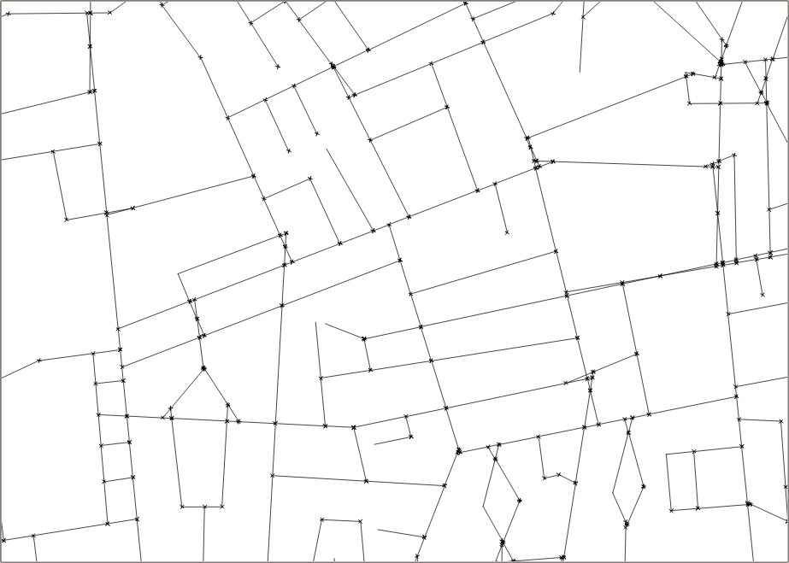
Space syntax theory
Segment maps and angular analysis
The segment map is the result of a transformation of the axial map, where the lines are broken at every intersection:
to obtain a more fine-grained measurement on long axial lines;

Slide 17
Space syntax theory
Segment maps and angular analysis
The segment map is the result of a transformation of the axial map, where the lines are broken at every intersection:
to obtain a more fine-grained measurement on long axial lines;
to allow the analysis of the different angles of intersection between axial lines

Slide 18
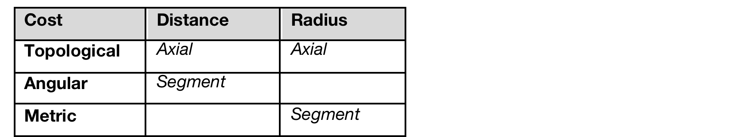
Space syntax theory
Radius and distance
The graph analysis can be carried out to all nodes in the graph, or just to nodes within a certain distance from a source.
This cut-off point is called the RADIUS of analysis. To all nodes the radius is called ‘Radius N’.
The type of COST used to calculate the distance of shortest paths and to determine the radius can vary, depending on the model:
Axial analysis: distance is always Topological, for paths and radius.
e.g. Axial Integration R3, or Axial Choice RN
Segment analysis: distance can be topological, metric or angular. BUT the standard in space syntax research is, Angular path distance, with Metric radius distance.
e.g. Segment Angular Choice R800m

Slide 19
The SST Project
Overview of the project
An open source project for space syntax education, research and practice
Initiated by the Space Syntax Laboratory, UCL
For the space syntax community
WITH contributions from the space syntax community
Aims of the project
Integrate space syntax spatial analysis (depthmapX) with QGIS
User friendly for students: clear and linear workflows
Flexible for researchers: analytic options and exploratory depth
Operational for practice: robust, fast and optimised workflows

Slide 20
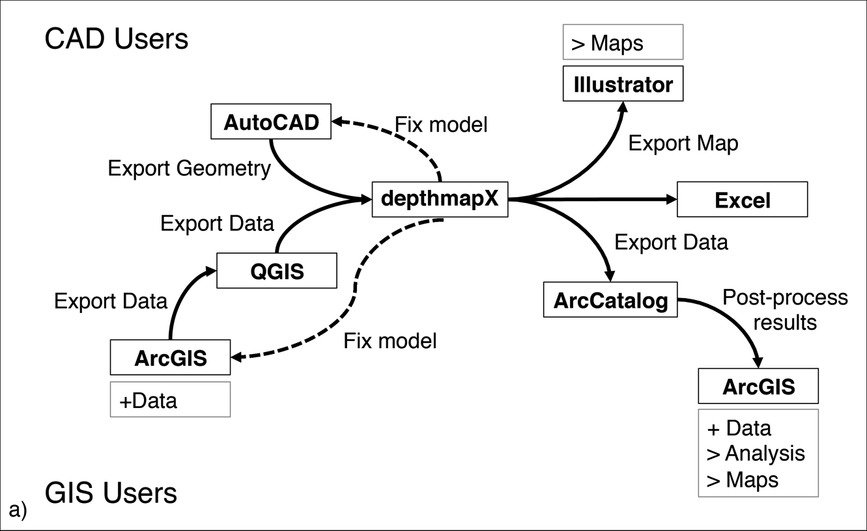
The SST Project

Slide 21
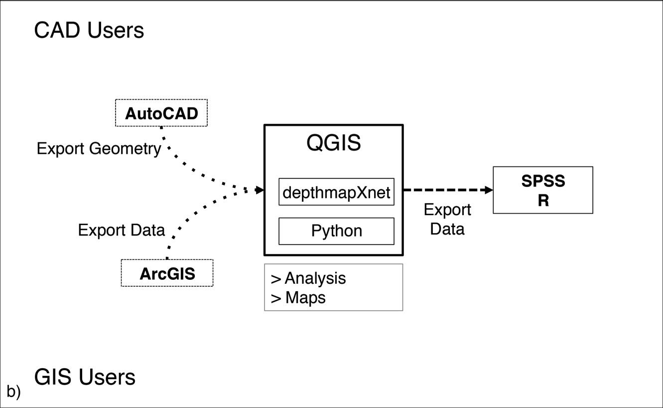
The SST Project

Slide 22
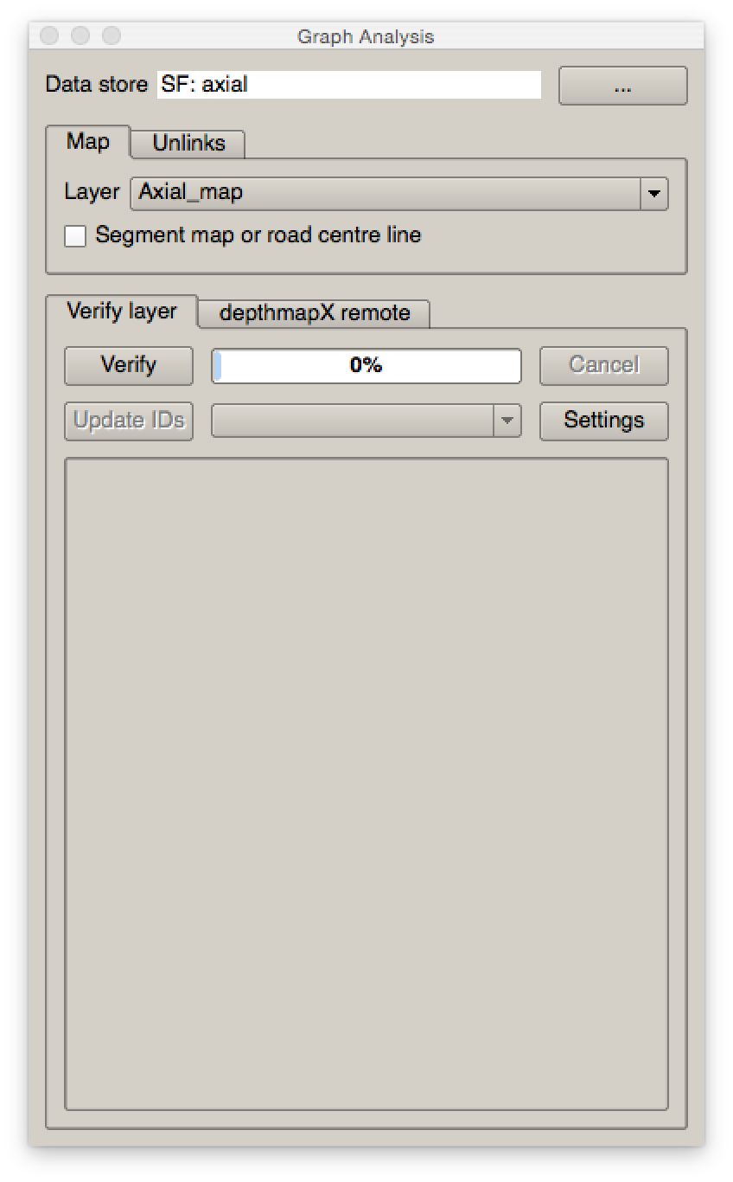
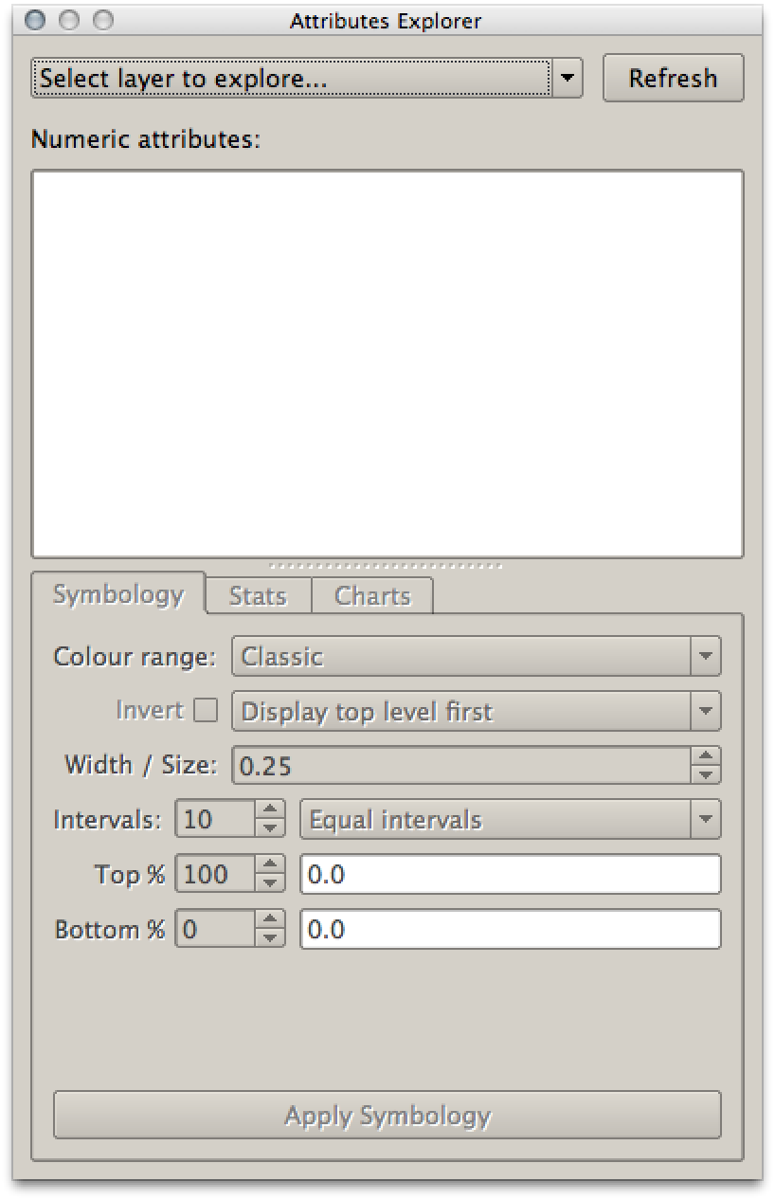
Original tools: SST version 0.1.x
Graph Analysis
Attribute Explorer

Slide 23
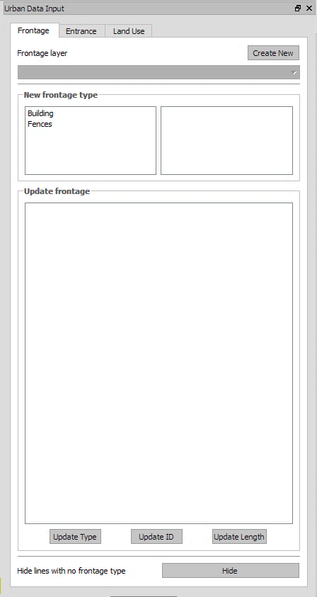
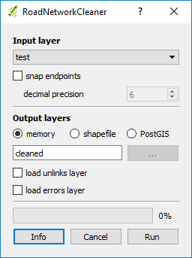
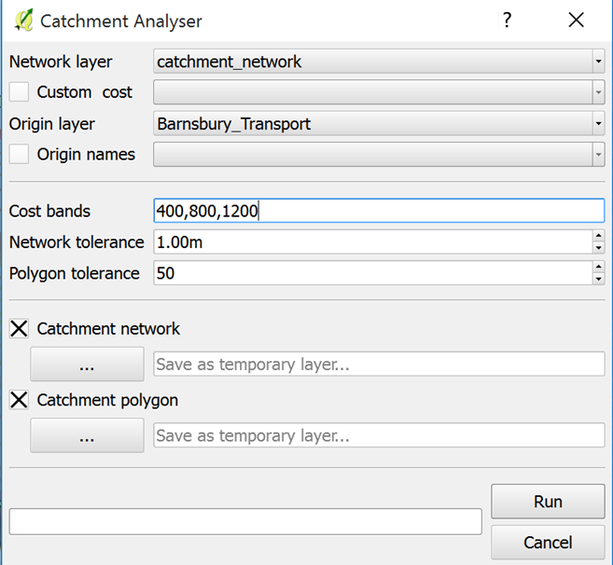
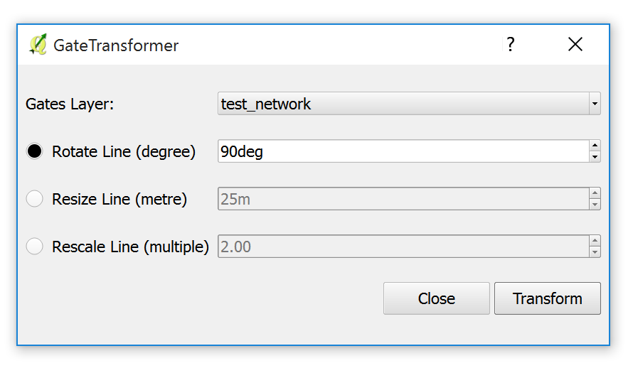
New Set of tools: SST version 0.2.0
Road network cleaner
Urban Data Input Tool
Catchment Analyser
Gate Transformer

Slide 24
Demo Workflow
Axial Map Verification
RCL Topology Cleaning
Unlinks Verification
Processing algorithm: simplify geometries
Space Syntax Analysis
Catchment Analyser
Visualisation
Gate Transformer/movement correlation
Urban data input
Integrated Urban Model

Slide 25
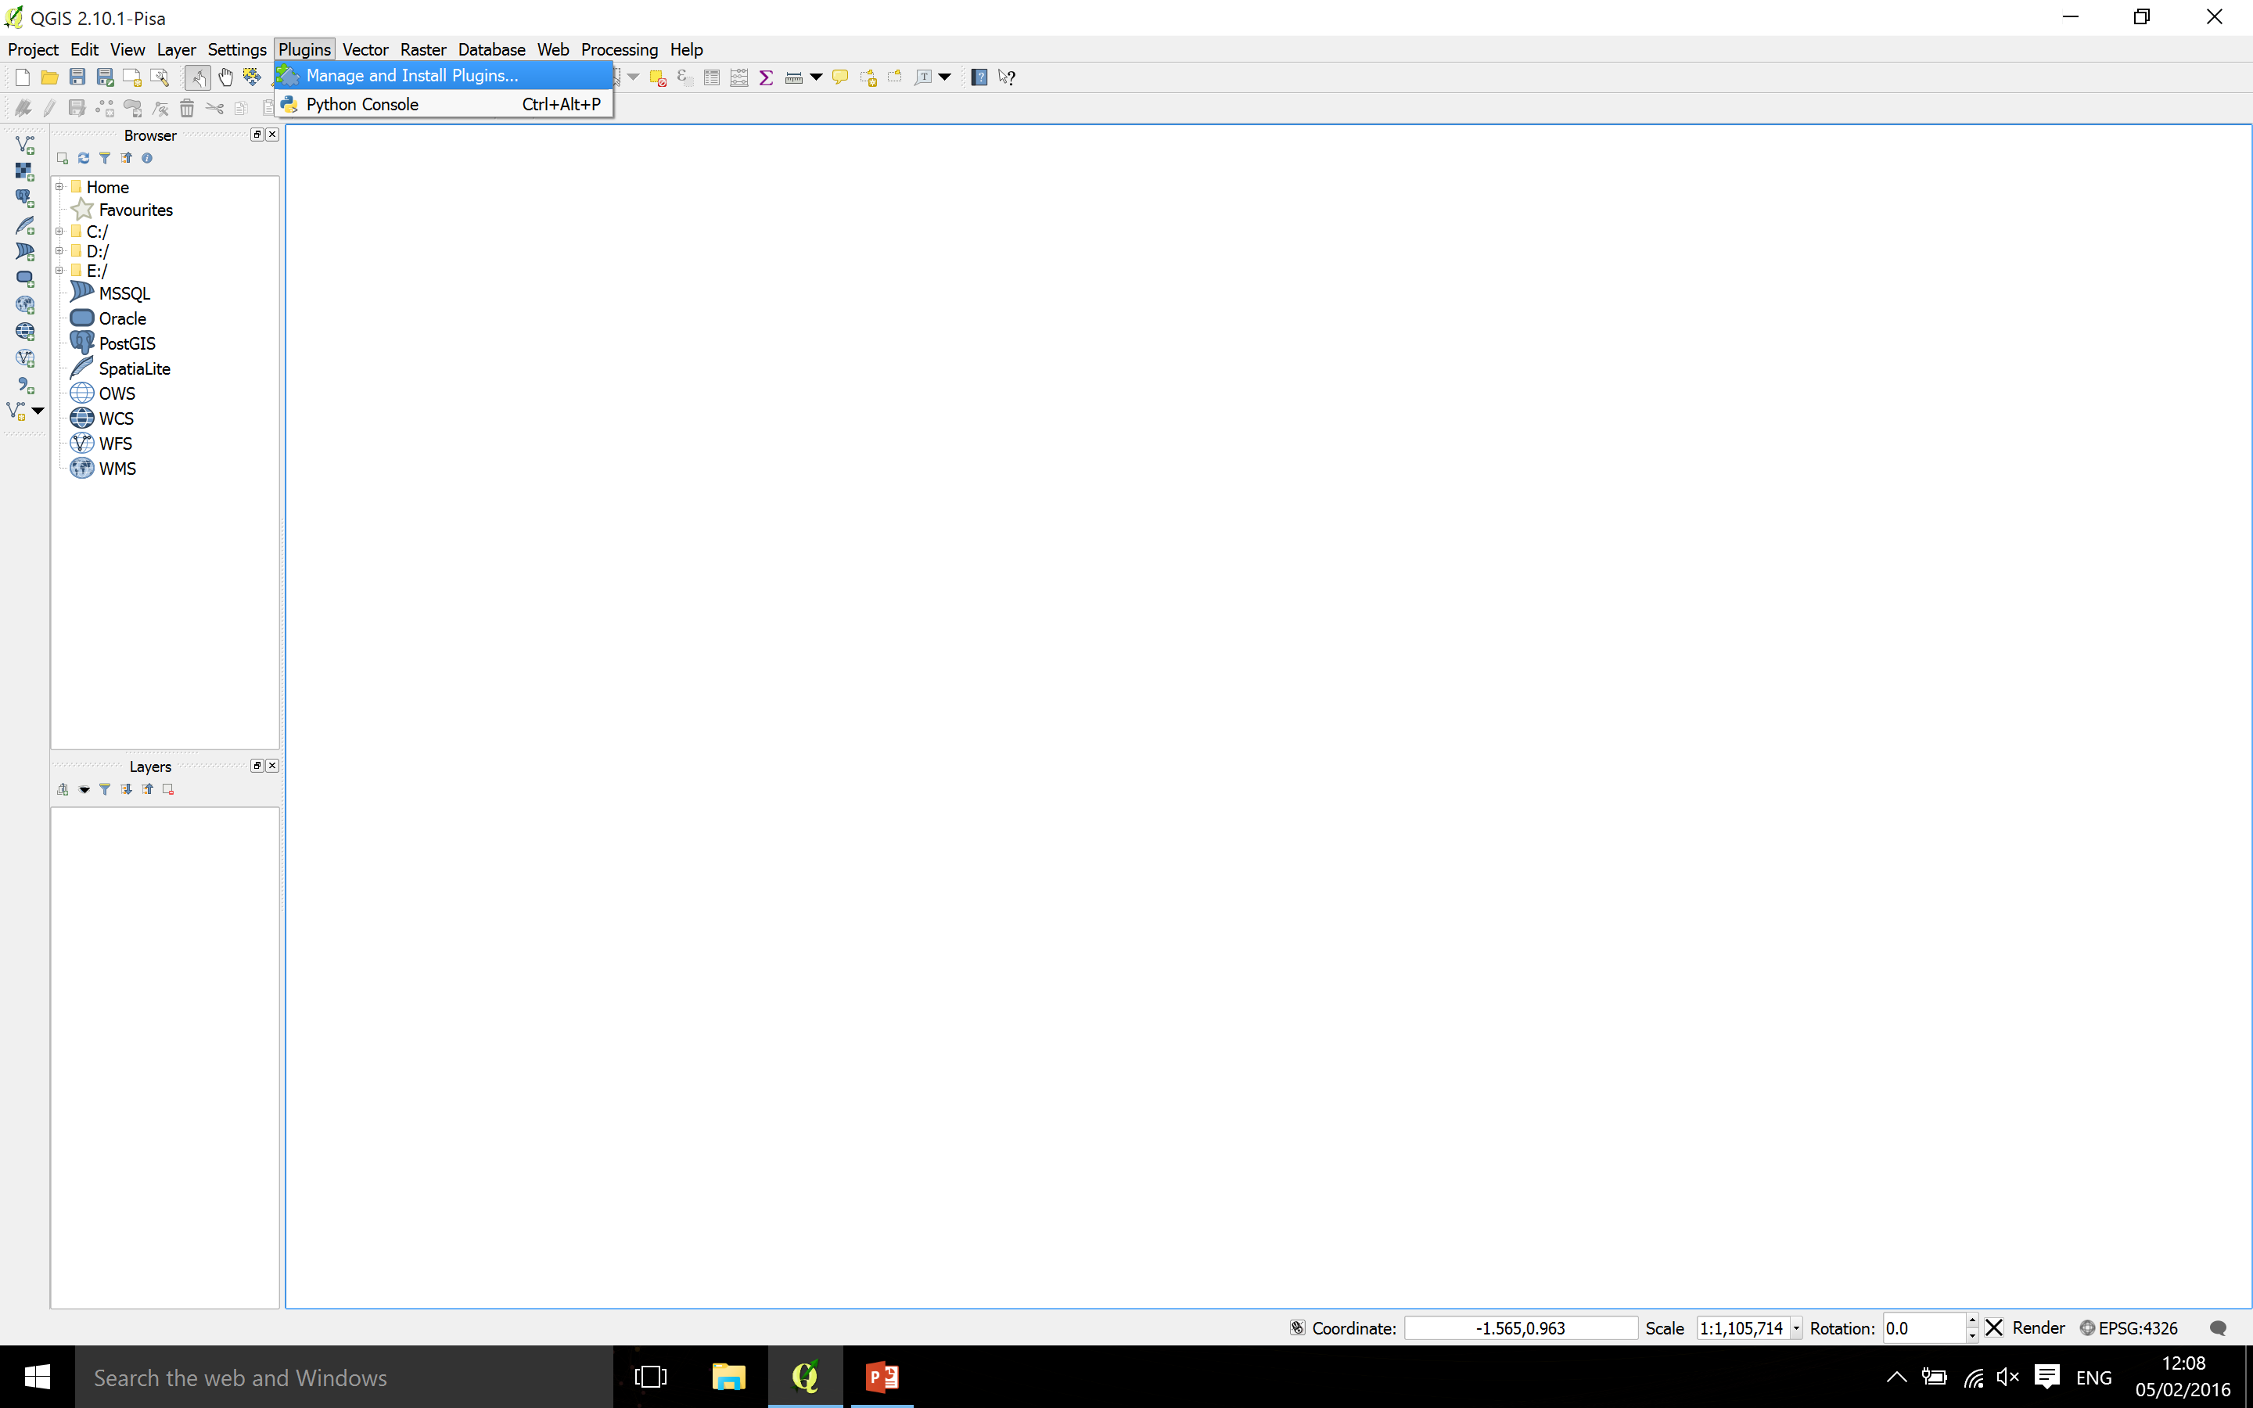
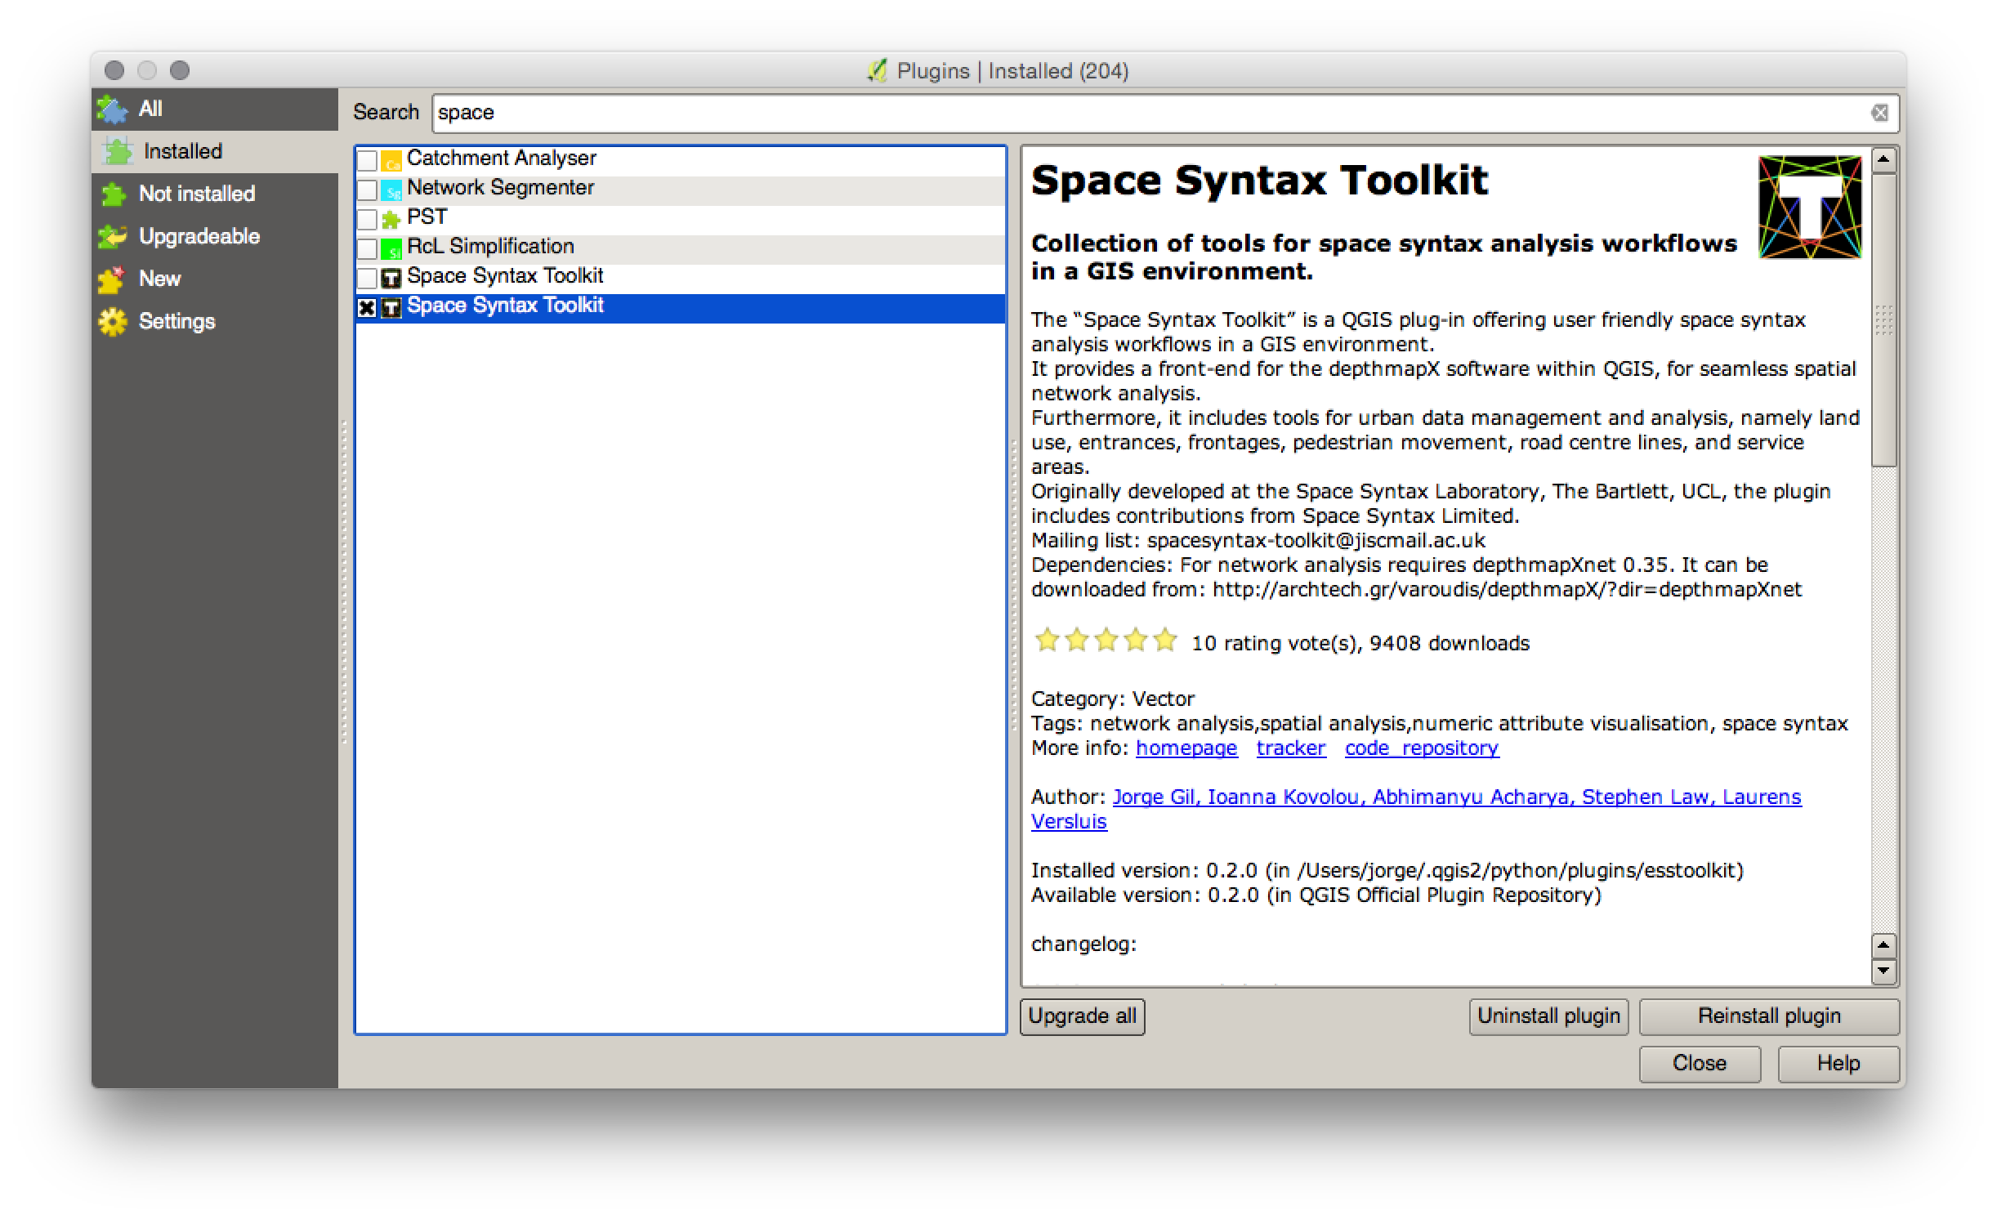
SST Installation

Slide 26
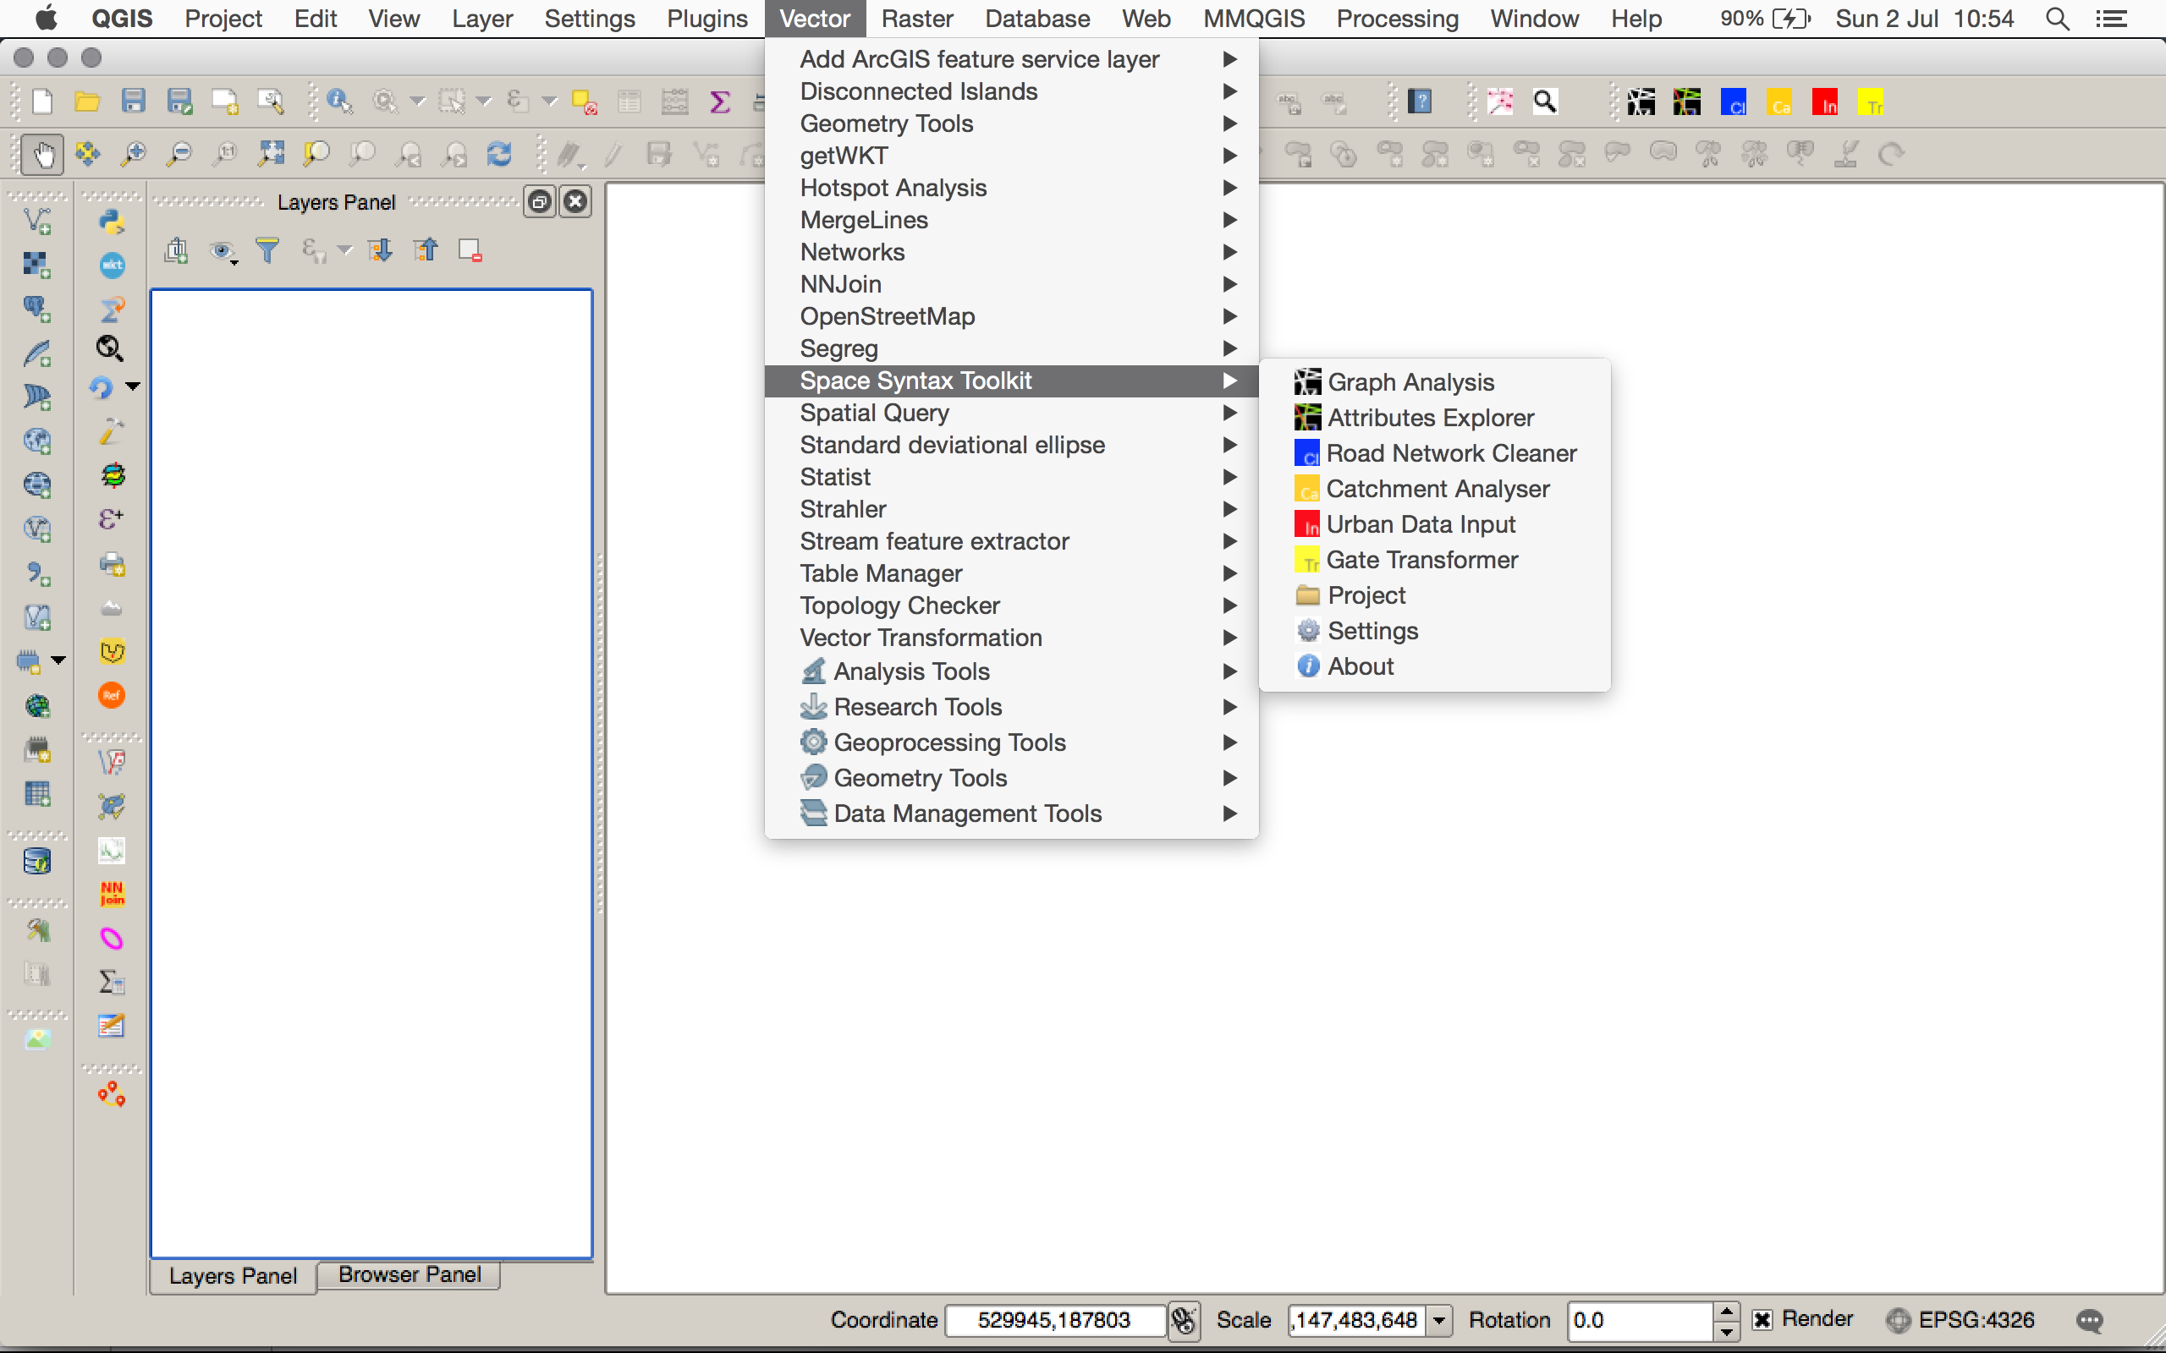
SST Installation

Slide 27
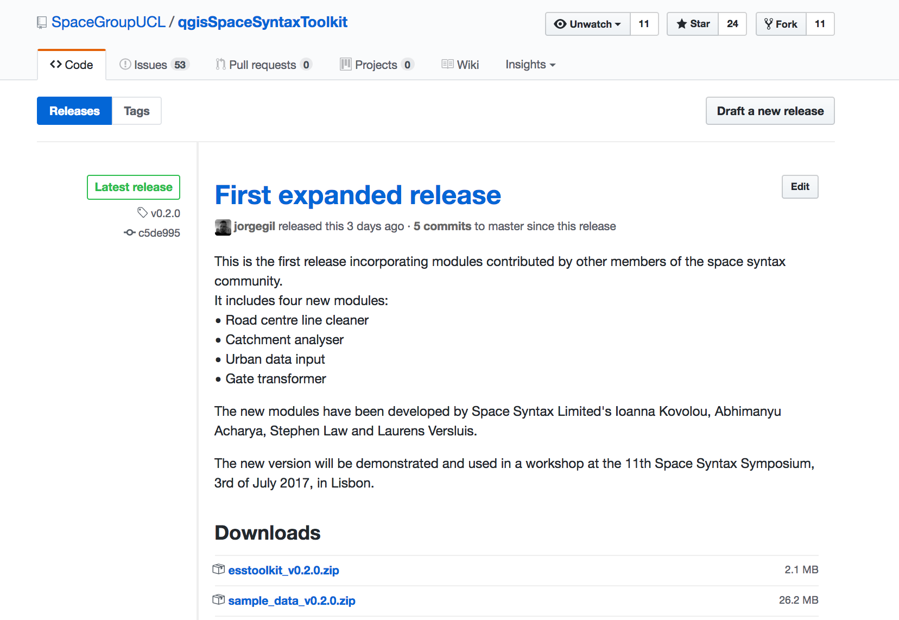
SST sample data
https://github.com/SpaceGroupUCL/qgisSpaceSyntaxToolkit/releases

Slide 28
Task 1
Preparing and analysing axial models
Model preparation: making axial and unlinks maps
Model verification: verifying the axial and unlinks maps
Model analysis: Axial and segment analysis of the axial model
Visualising the results

Slide 29
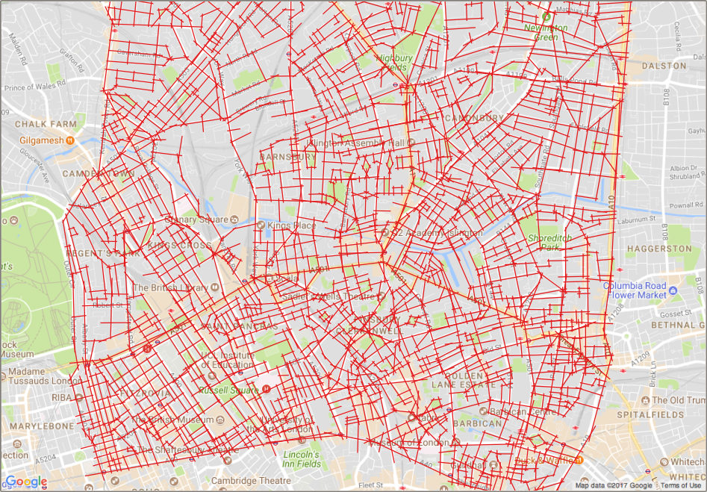
Model preparation: making axial and unlinks maps
Drawing an axial map (use a projected CRS!)

Slide 30
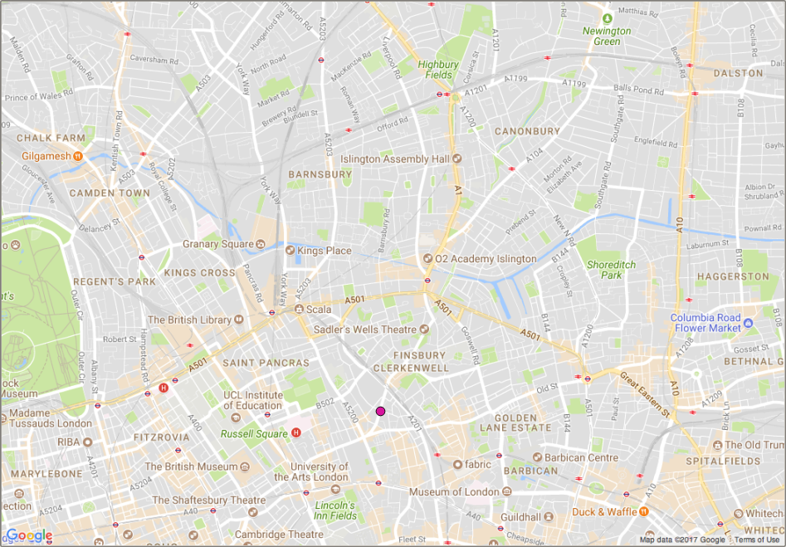
Model preparation: making axial and unlinks maps
Drawing an unlinks map

Slide 31
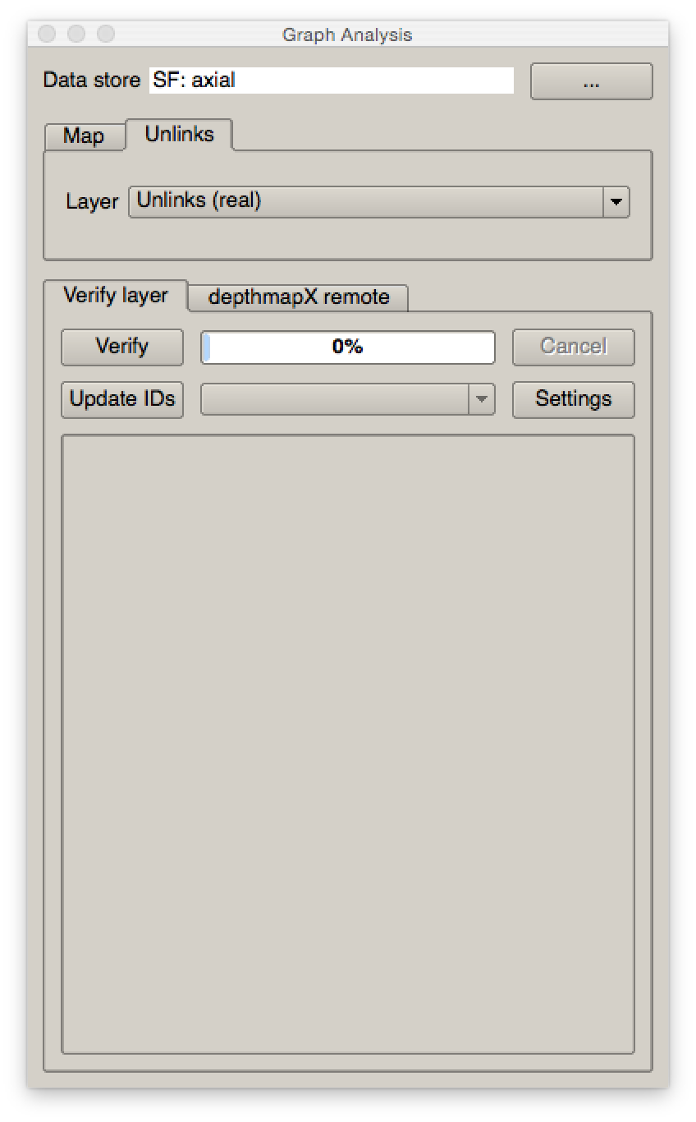
Model verification: verifying the axial and unlinks maps
Load the layers in the Graph Analysis Tool

Slide 32
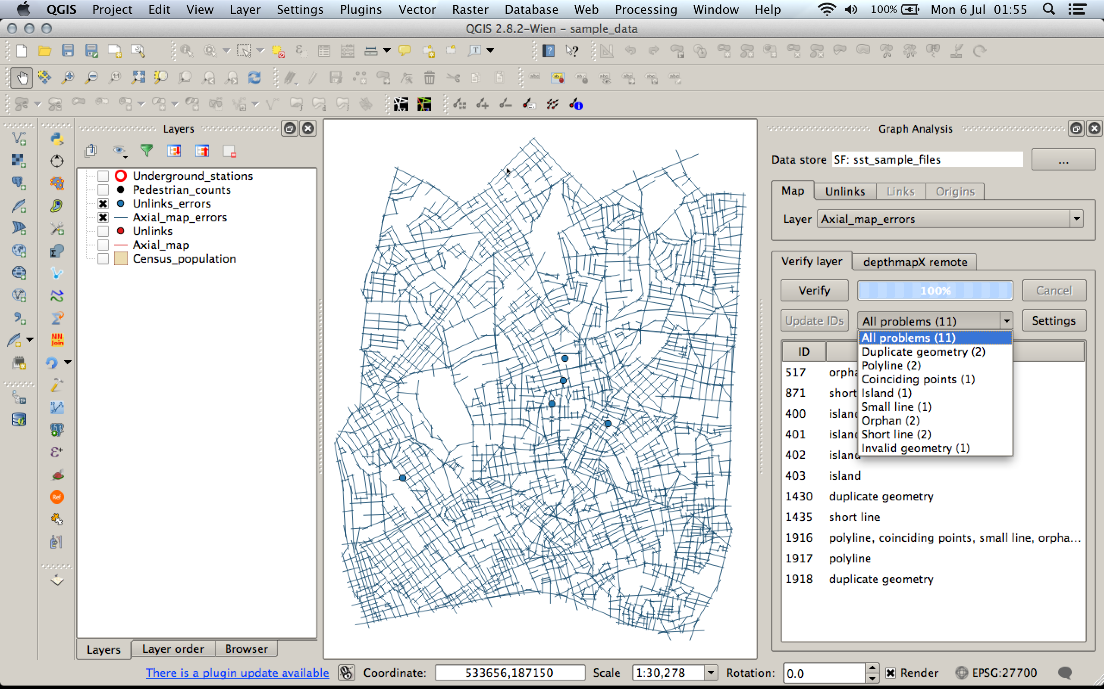
Model verification: verifying the axial and unlinks maps
Verification is done on the two layers combined

Slide 33
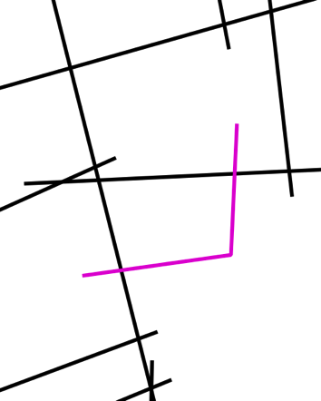



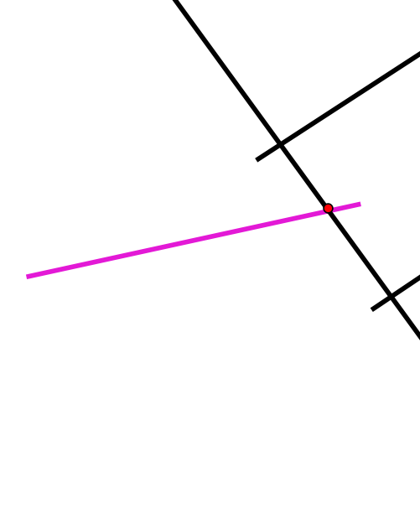

Model verification: verifying the axial and unlinks maps
Axial map errors
Polyline
Duplicate
Undershoot
(short line)
Orphan
Unlinked orphan
Island
Small
Coinciding points
a)
b)
c)
d)
e)
f)

Slide 34
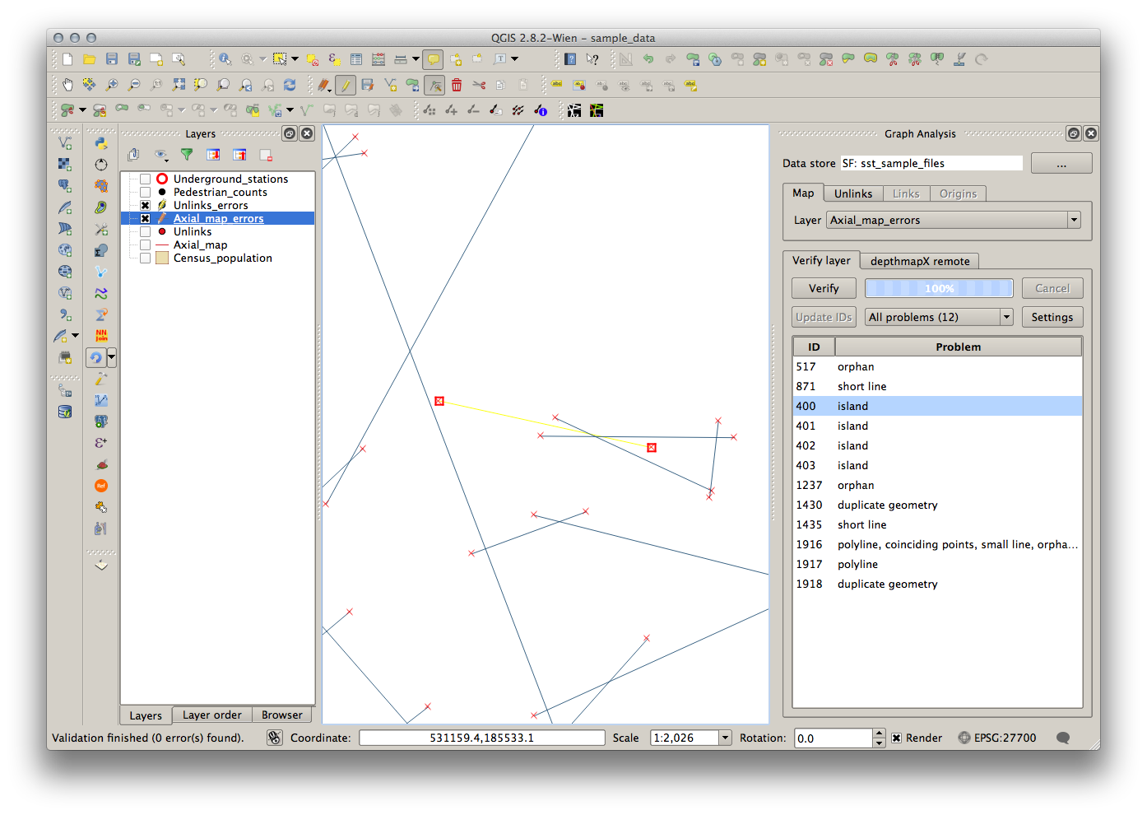
Model verification: verifying the axial and unlinks maps
Correcting the axial map

Slide 35

Model verification: verifying the axial and unlinks maps
Correcting the axial map

Slide 36
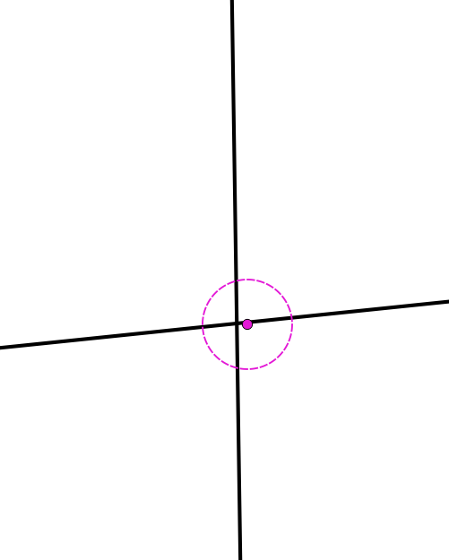
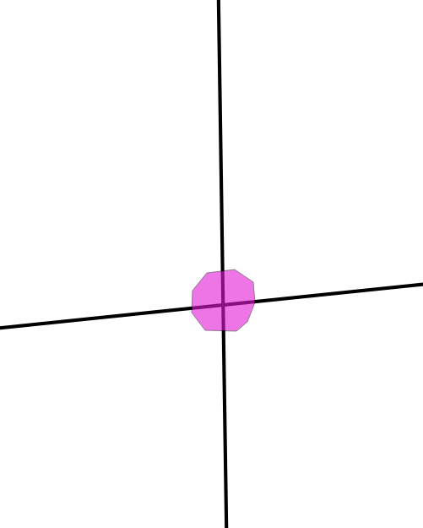

Model verification: verifying the axial and unlinks maps
Representing unlinks

Slide 37
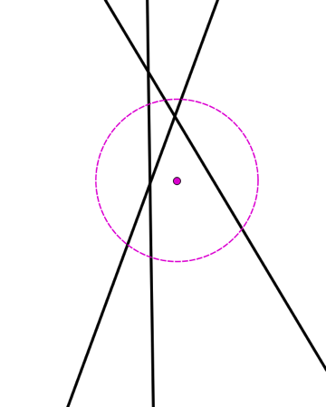
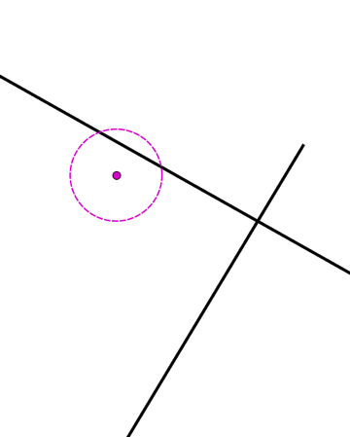
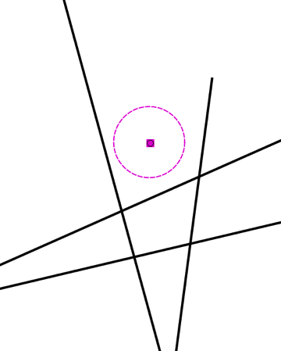
Model verification: verifying the axial and unlinks maps
Unlink errors
Feature errors:
More than 2 lines
Single line
No lines
Attribute error:
No line id
Same line id
Unmatched line id
3
1
2

Slide 38
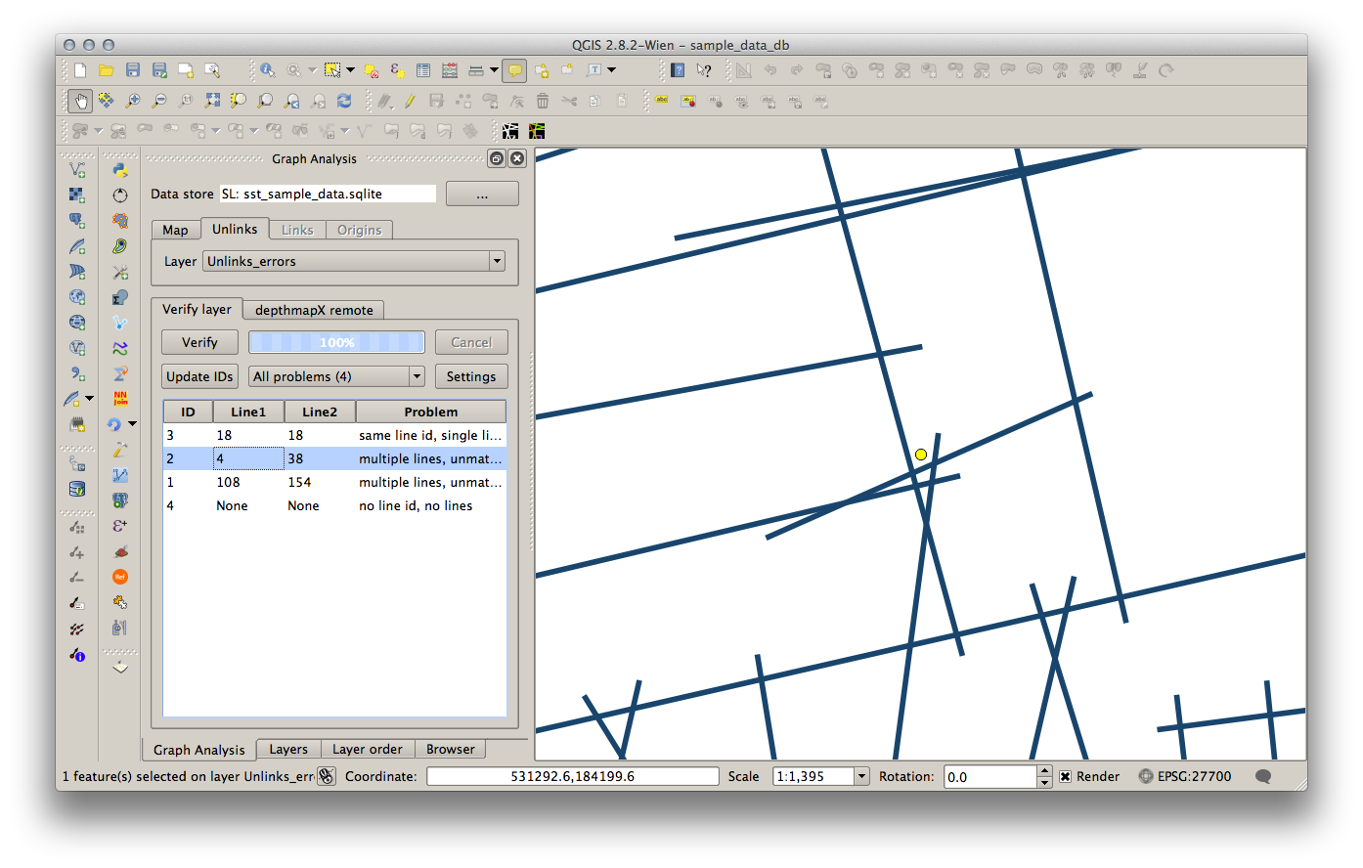
Model verification: verifying the axial and unlinks maps
Correcting the unlinks map

Slide 39
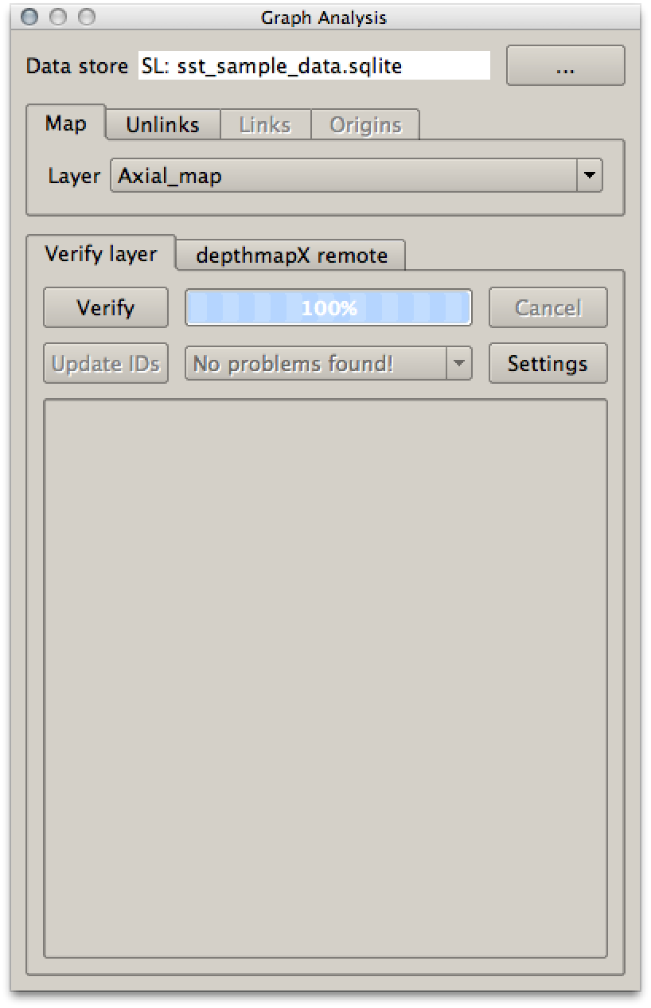
Model verification: verifying the axial and unlinks maps
Axial model verification workflow
It’s an iterative process that stops when the verification of axial map and unlinks returns no errors.
Verify and fix axial lines
Update unlinks ids
Verify and fix unlinks
Verify and fix axial lines
Verify and fix unlinks
Update unlink ids
Verify and fix axial lines
…

Slide 40
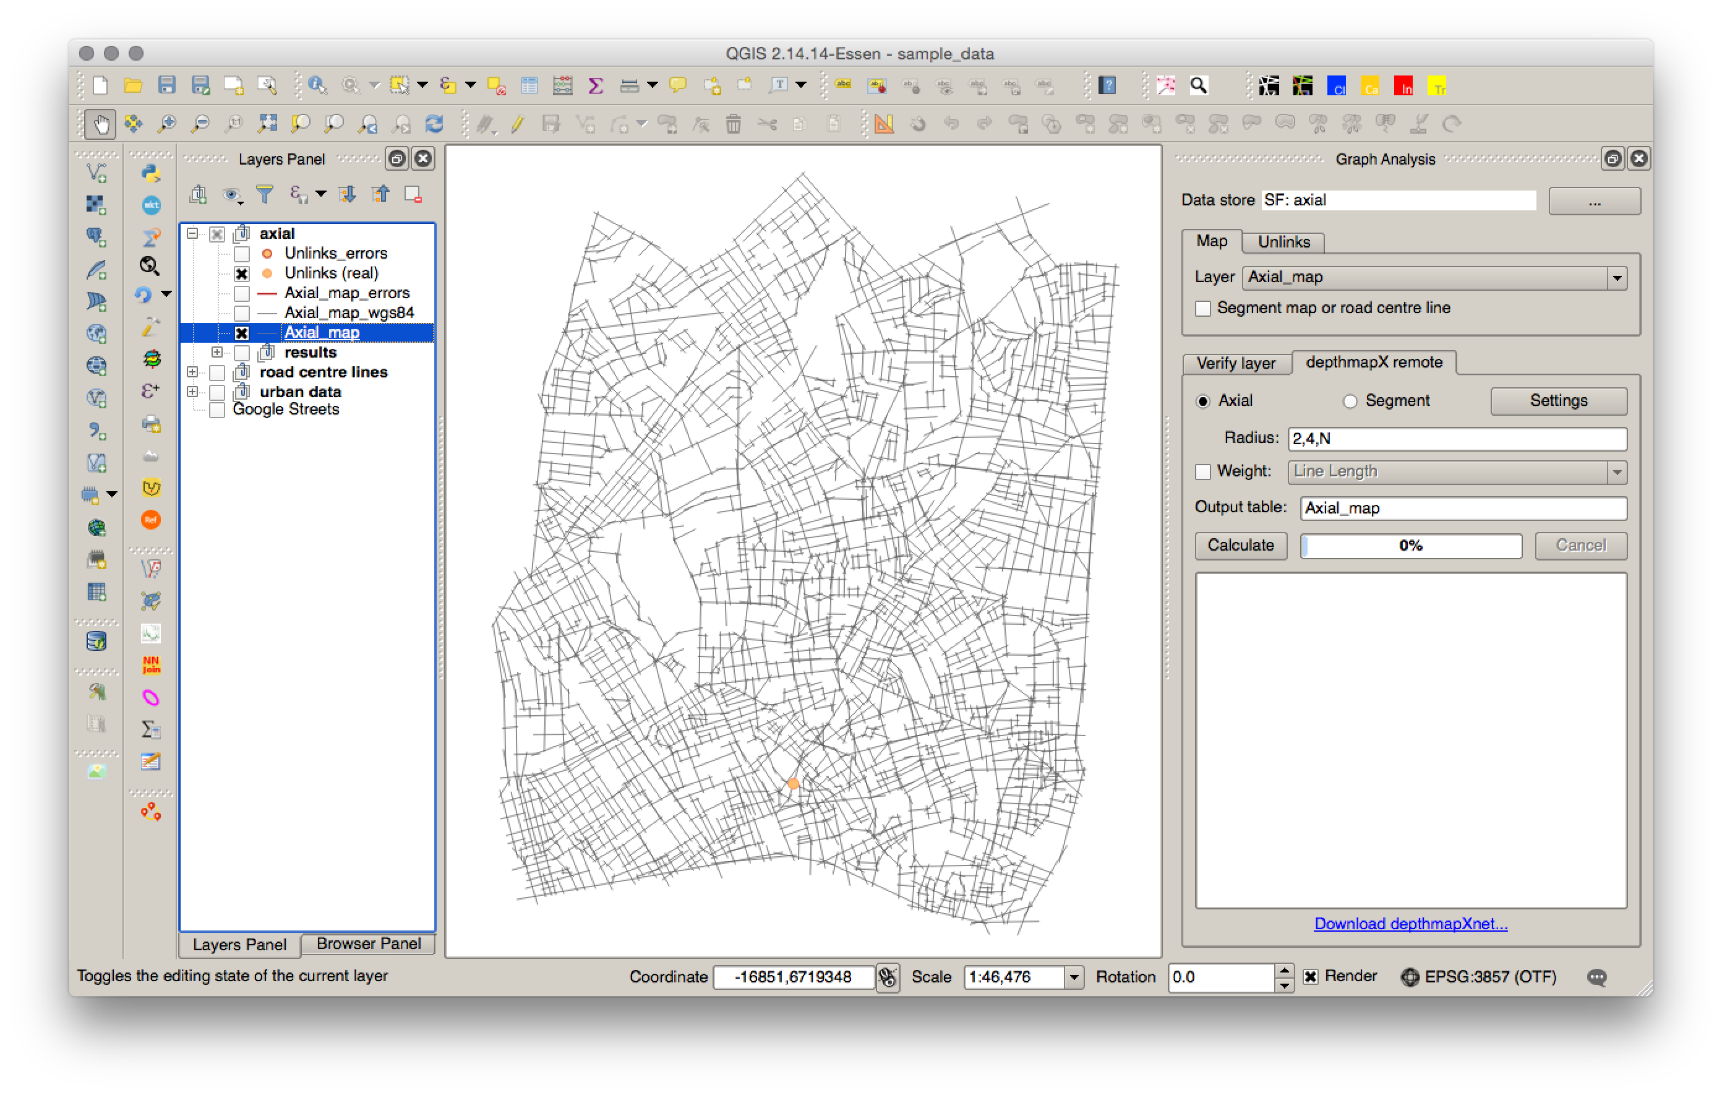
Model analysis: Axial analysis of the axial model
DepthmapX remote axial analysis settings

Slide 41

Model analysis: Segment analysis of the axial model
DepthmapX remote segment analysis settings

Slide 42
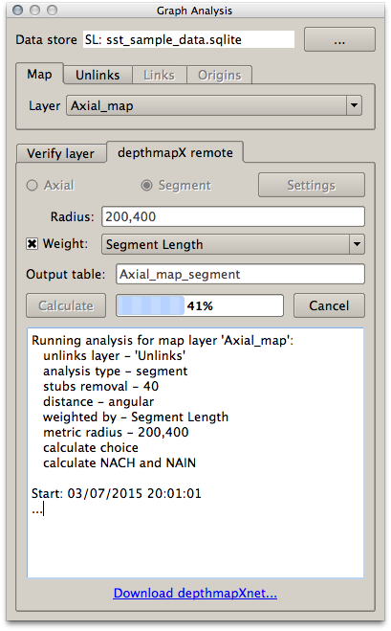
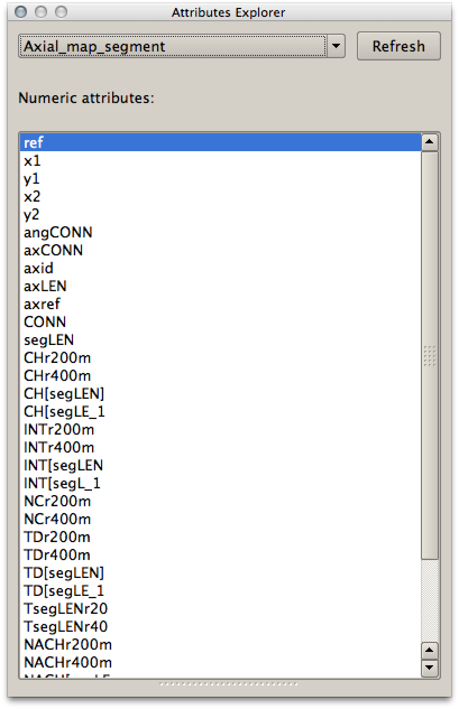
Model analysis
Results report and postprocessing the results

Slide 43
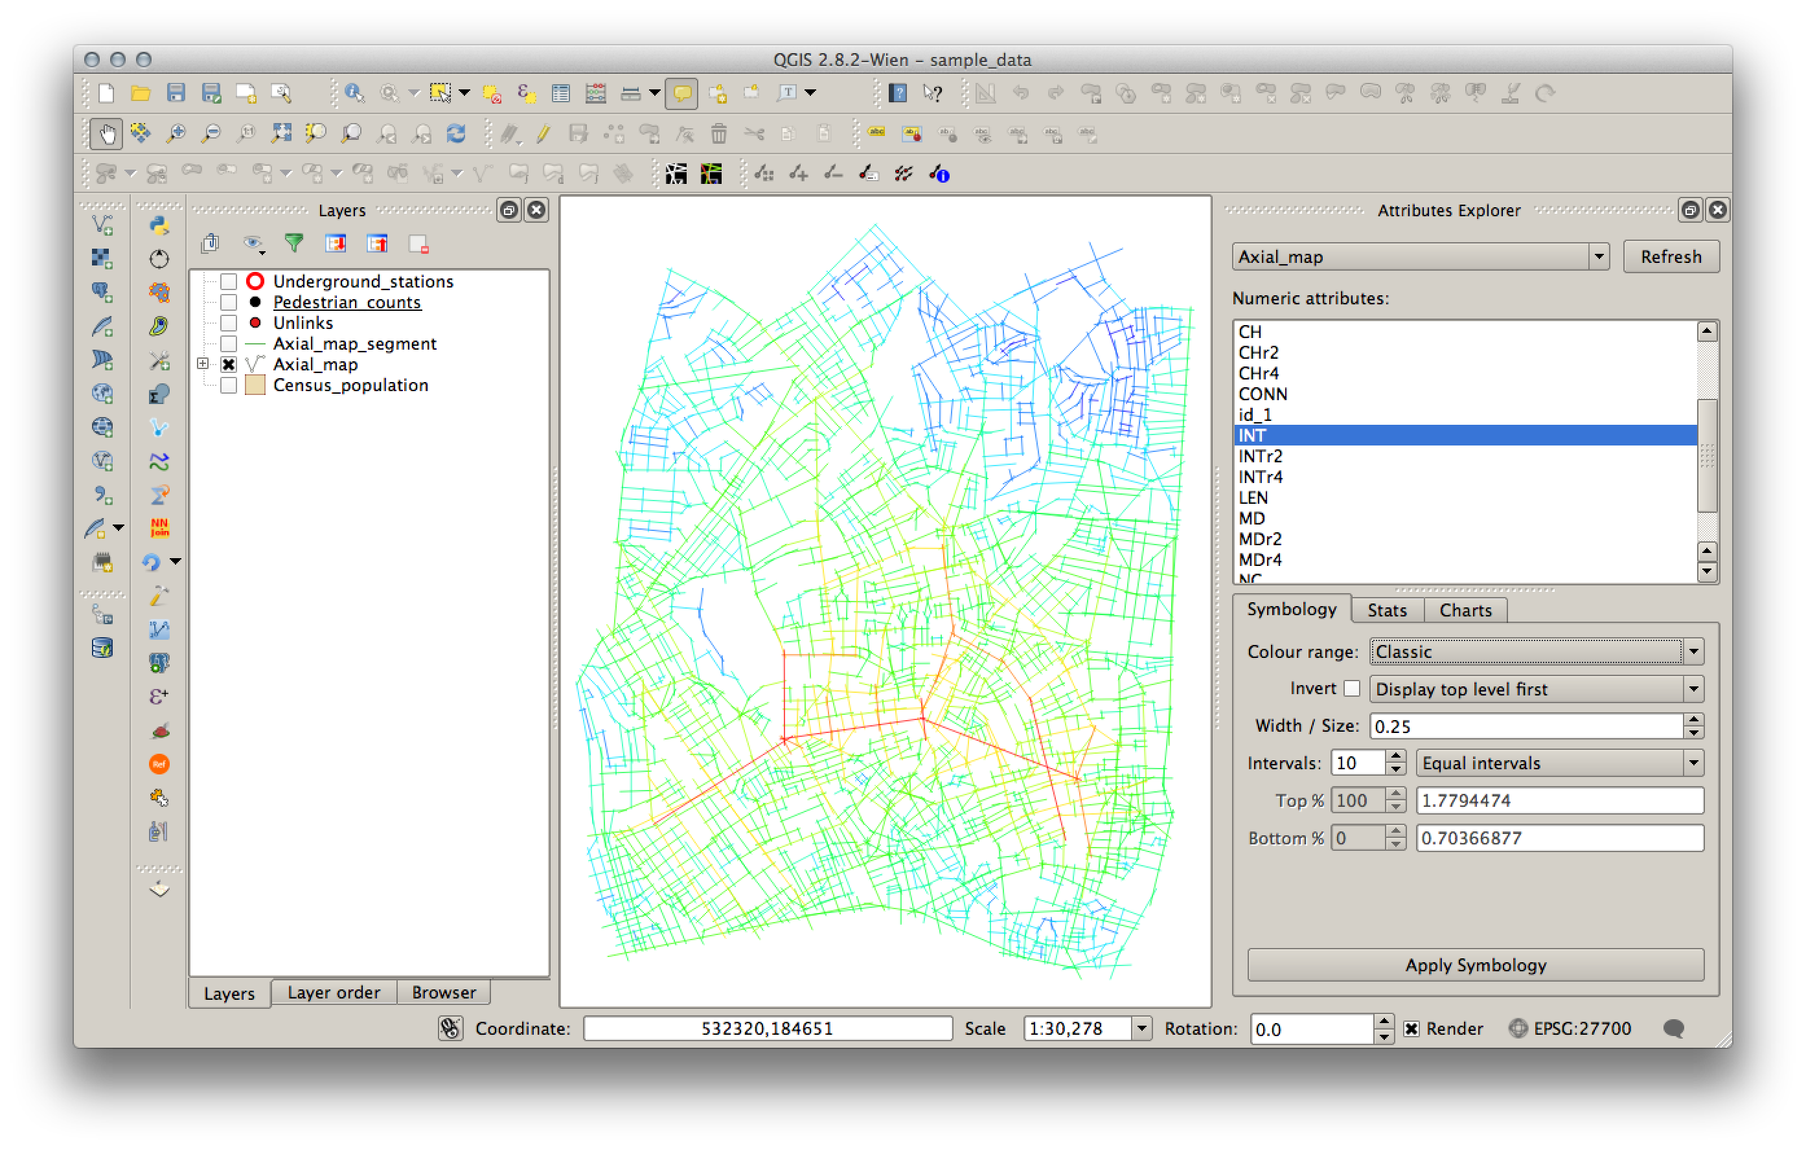
Visualising the results
Loading analysis results in Attributes Explorer Tool

Slide 44


Slide 45
Task 2
Preparing and analysing road centre line (RCL) models
Comparing RCL maps
Cleaning RCL maps
Simplifying RCL maps
Verifying RCL maps
Analysing RCL maps

Slide 46
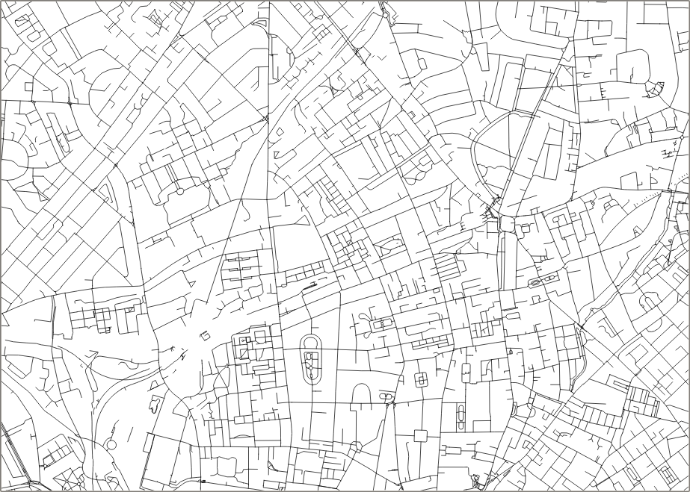

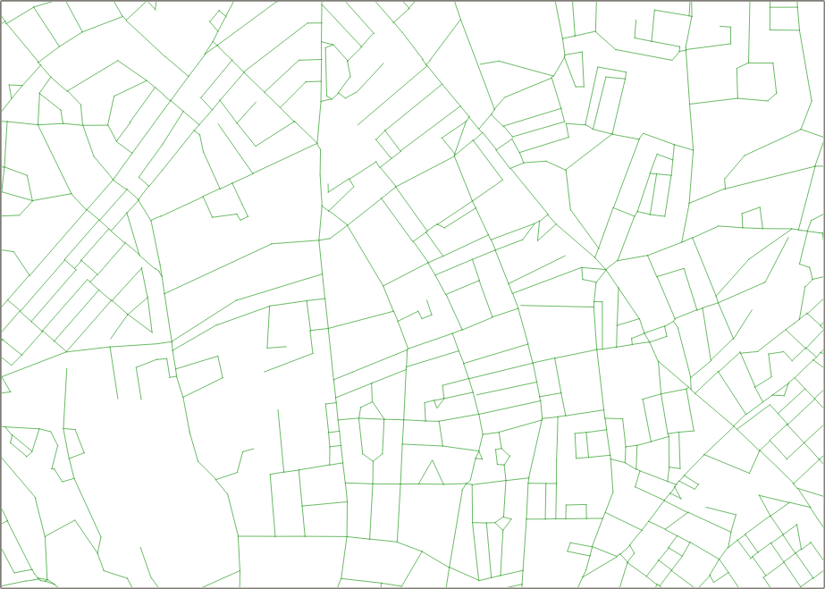
Comparing Road Centre Line maps
OpenStreetMap
OS Open Roads
OS Meridian 2

Slide 47
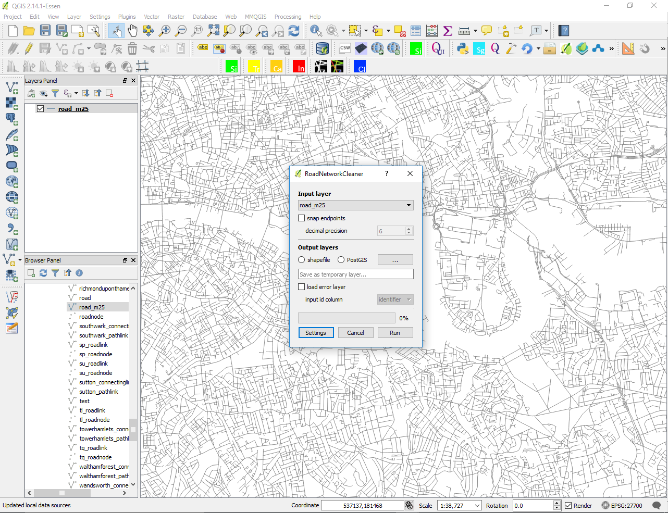
Cleaning RCL maps: Road network cleaner tool
This plugin corrects topological errors of Road-centre-line (RCL) maps. This is a necessary step before performing space syntax analysis to any network.

Slide 48
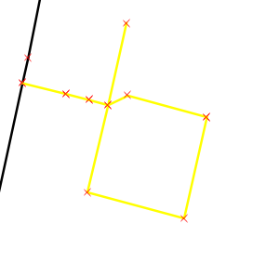
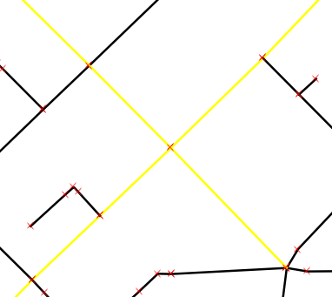
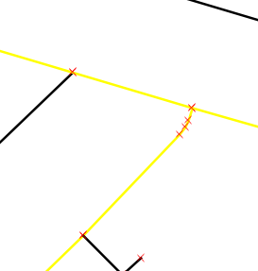
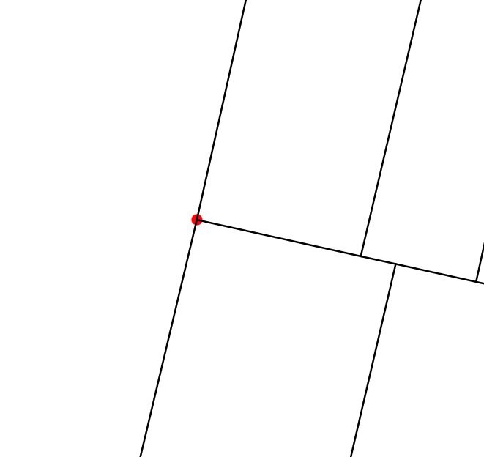
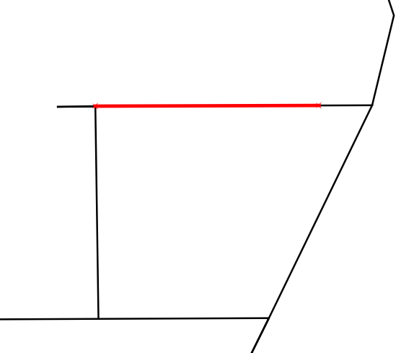
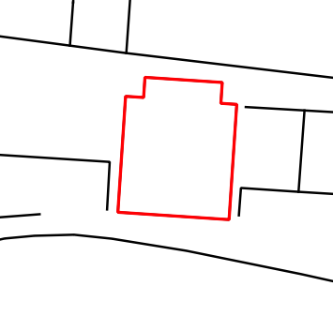
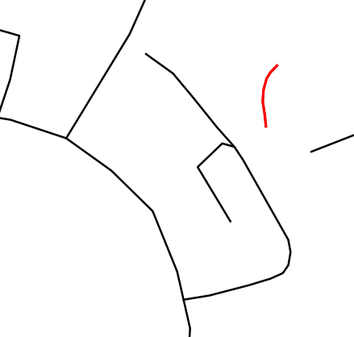
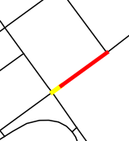
Road network cleaner
Geometry
Topology
Removes invalid geometries
Breaks geometries at self intersection (1), at shared vertices (2) and where they touch endpoints of other lines (3).
Breaks multi-part geometries
x
x
x
Removes point geometries
Removes duplicate and overlapping (1) geometries, closed polylines that do not connect to any other line (2) and isolated lines (3).
Merges lines between intersections

Slide 49
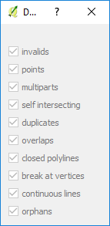
Road network cleaner
Input layer Choose RCL map to clean. The input can be any QGIS layer.
Snap endpoints The user can specify a decimal precision of the coordinates
Output layers The user can choose between a memory QGIS layer a shapefile or a PostGIS database layer.
Load error layer The errors that have been corrected by the plugin can be loaded as a memory layer.
Load unlinks layer There is an option to create a memory unlinks layer where the lines of the input layer cross. However, unlinks should be verified by the user as RCL may represent differently unlinked lines.
Info See which topological errors are corrected.
Run Pressing run will perform the cleaning of the selected map
Cancel Pressing close will close and terminate the Road network cleaner

Slide 50
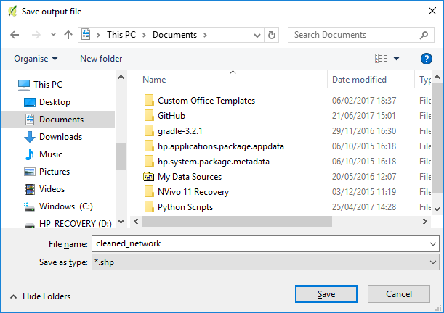
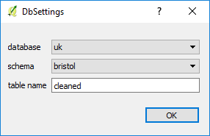
Road network cleaner
Shapefile
Save output file: Select the location you wish to save the cleaned shapefile.
PostGIS layer
Database Select the database where to save the cleaned layer
Schema Select the schema where to save the cleaned layer
Table name Specify the table name of the cleaned layer or leave it as default (‘cleaned’)

Slide 51


Cleaning RCL maps
OpenStreetMap
OS Open Roads
input
input

Slide 52


Cleaning RCL maps
OpenStreetMap
OS Open Roads
errors
errors

Slide 53


Cleaning RCL maps
OpenStreetMap
OS Open Roads
output
output

Slide 54

Simplifying RCL maps
Douglas-Peucker generalisation algorithm
Source: https://www.researchgate.net/figure/260758647_fig6_Figure-6-Simplification-of-a-polygonal-curve-with-the-Douglas-Peucker-algorithm-A

Slide 55

Simplifying RCL maps
QGIS – Simplify geometries

Slide 56


Simplifying RCL maps
OpenStreetMap
OpenStreetMap
Simplification tolerance 10
Simplification tolerance 20

Slide 57


Simplifying RCL maps
OS Open Roads
OS Open Roads
Simplification tolerance 10
Simplification tolerance 20

Slide 58

Simplifying RCL maps
OS Meridian 2
OS Open Roads
No simplification
Simplification tolerance 20

Slide 59

Analysing RCL maps
Graph Analysis tool
Map
Segment map or road centre line: Tick this option when you are analysing road centre line maps or axial maps already segmented.

Slide 60

Verifying RCL maps
Graph Analysis tool
Unlinks
Verify the unlinks: This is required in the cases where the cleaning tool produces a meaningful unlinks result file, e.g. OS OpenRoads and OS Meridian2.

Slide 61




Verifying RCL maps
Fixing a missing RCL unlink by moving the nodes so that the segments cross at the location. Use of snapping options is important.

Slide 62


Analysing RCL maps
OpenStreetMap
OS Open Roads
Integration RN, 10 equal ranges
Integration RN, 10 equal ranges
The difference between the two maps is partly to do with the existence of islands in the OpenStreetMap model. These can be verified and fixed using the Axial layer verification tool.
The islands affect the data distribution and consequently the ranges of the colour scale.

Slide 63
Visualisation and discussion of the results so far
Road centre lines or axial maps: which model is more appropriate?
How should we visualise different centrality metrics?

Slide 64

Visualisation and discussion of the results
Road centre lines: which model is more appropriate?

Slide 65

Visualisation and discussion of the results
Road centre lines: which model is more appropriate?

Slide 66

Visualisation and discussion of the results
Changing colour range

Slide 67

Visualisation and discussion of the results
Changing intervals: 10 quantiles

Slide 68

Visualisation and discussion of the results
Changing intervals: equal ranges with Choice

Slide 69

Visualisation and discussion of the results
Changing intervals: 10 quantiles with Choice

Slide 70

Visualisation and discussion of the results
Changing intervals: custom range with Choice

Slide 71


Slide 72
Task 3
Preparing other urban data layers
Urban Data Input Tool: recoding frontages, entrances and land use surveys
Creating the data layer
Drawing new features
Updating features
Viewing the attributes

Slide 73

Urban Data Input Tool
Urban Data Input Tool is a plugin to ease aid the input of urban data like frontage type, entrance type and land use type as per Space Syntax Limited standards. The Space Syntax community is the key users for the plugin. The display styles and categories included are as per Space Syntax Limited Standards.

Slide 74


Urban Data Input Tool
Frontage survey
Entrance survey
Land use survey

Slide 75



Urban Data Input Tool
Frontage tool
Entrance tool
Land use tool

Slide 76

Urban Data Input Tool Frontage tool
Data categories
Create New Frontage layer
Using buildings/block dataset
Without using building/block dataset
Frontage Category
Selected feature data
Update buttons
Hide lines with no data

Slide 77
Urban Data Input Tool Frontage tool

Slide 78

Urban Data Input Tool Entrance tool
Data categories
Create New Entrance layer
Entrance Category
Selected feature data
Update buttons

Slide 79
Urban Data Input Tool Entrance tool

Slide 80

Urban Data Input Tool Land use tool
Data categories
Create New Land use layer
Land use Category
Building data/ description
Selected feature data
Update buttons

Slide 81
Urban Data Input Tool Land use tool

Slide 82
Task 4
Connecting and analysing the various results
Catchment Analyser: calculating service/catchment areas from different locations (e.g. public transport nodes) along the road centreline network.

Slide 83

Catchment Analyser
This plugin takes a line-based network and point-based origin layer and calculated the distance from each segment within a given distance or list of distances to each of the origins. The tool outputs the catchment as lines and as a concave hull polygon layer. Credit for the concave hull functionality goes to the algorithm described by Adriano Moreira and Maribel Yasmina Santos.

Slide 84

Catchment Analyser
Network layer Choose the line-based vector layer that comprises a topological network you want to analyse. (projected CRS only!!)
Origin layer Choose the point-based vector layer containing the origins from which catchment will be calculated.
Origin Names By default the origin names will be based on the feature ids. If checked the tool will run the catchment analysis based on the column selected.
Cost Bands This sets the radius for the catchment analysis. For example, 400,800,1200,2000.
Network tolerance This is a tolerance for disconnected network. For example, it will connect lines that are within 1m by default.
Polygon tolerance The Catchment Analyser tool creates concave hull polygons from a specific origin. The polygon tolerance defines the level of 'concaveness' of the catchment. The lower the value, the more concave and the higher the value the more convex.
Catchment network The tool provides a catchment network output based on the original network layer with cost information on every origin. If checked the tool will generate the network as a temporary layer or as a shapefile using the browse button.
Catchment polygon The tool provides a catchment polygon output for each origin and each specified cost. If checked the tool will generate the polygons as a temporary layer or as a shapefile using the browse button.

Slide 85
Task 4
Connecting and analysing the various results
Gate Transformer: preparing pedestrian counts
Connecting the results layers with pedestrian counts
Statistical analysis of two variables

Slide 86

Gate Transformer
Gate Transformer is a plugin to modify the geometry of gates used in space syntax movement observations. Gates are usually drawn perpendicular to the axial line, with varying lengths. For presentation of movement observations the typical output is a map showing lines along the axial lines to indicate the movement direction. The gates should all be rotated 90degrees and have the same length.

Slide 87


Gate Transformer
Gates layer Choose the line-based gate layer from the drop-down menu that you want to transform
Rotate Line (degree) Define the angle in degrees for rotating the selected gates
Resize Line (metre) Define the length in metres for resizing the selected gates
Rescale Line (multiple) Define the multiple in ratio for rescaling the selected gates
Transform Pressing the transform button will activate the analysis for the selected transformation
Close Pressing close will close and terminate the Gate Transformer
Rotate Line
Resize Line
Rescale Line

Slide 88

Connecting layers by spatial join
Use the ‘Join attributes by location’ from the processing toolbox

Slide 89

Statistical analysis of two variables

Slide 90


Visualising other layers with Attributes Explorer

Slide 91


Visualising other layers with Attributes Explorer

Slide 92
Questions and Discussion
QGIS methods for space syntax research
Open to questions from the participants
Connecting and analysing other data layers?
Analysis with R and other statistics packages?

Slide 93

SST Github repository
https://github.com/SpaceGroupUCL/qgisSpaceSyntaxToolkit

Slide 94

SST Issues
https://github.com/SpaceGroupUCL/qgisSpaceSyntaxToolkit/issues

Slide 95

SST Wiki
https://github.com/SpaceGroupUCL/qgisSpaceSyntaxToolkit/wiki

Slide 96
Thank you!
SST mailing list:
https://www.jiscmail.ac.uk/cgi-bin/webadmin?A0=SPACESYNTAX-TOOLKIT
Space syntax mailing list:
https://www.jiscmail.ac.uk/cgi-bin/webadmin?A0=SPACESYNTAX

